Slide 1


Natural Language Processing - 2nd Semester (2024-2025) 1038141
1.10 - Semantics
Prof. Stefano Faralli
faralli@di.uniroma1.it
Prof. Iacopo Masi
masi@di.uniroma1.it
**credits are reported in the last slide
Notes:
1

Slide 2
1.10 - Semantics
Semiotic Triangle, From Syntax to Semantics
Syntax-driven semantic analysis: semantic attachments
First-Order Logic, lambda calculus for NLP
Lexical Semantics, lemmatization, word senses, monosemy vs. polysemy, homonymy, metonymy, metaphor, personification, synesthesia, enumerative approach, generative approach.
WordNet, BabelNet
Word Sense Disambiguation, Entity Linking, Ontology Learning
Q&A
Natural Language Processing - 1.10 Semantics

Slide 3

Milestones in NLP
today topic is fundamental for the three areas.
rule-based systems
statistical classical machine learning models
deep learning models
Natural Language Processing - 1.10 Semantics

Slide 4
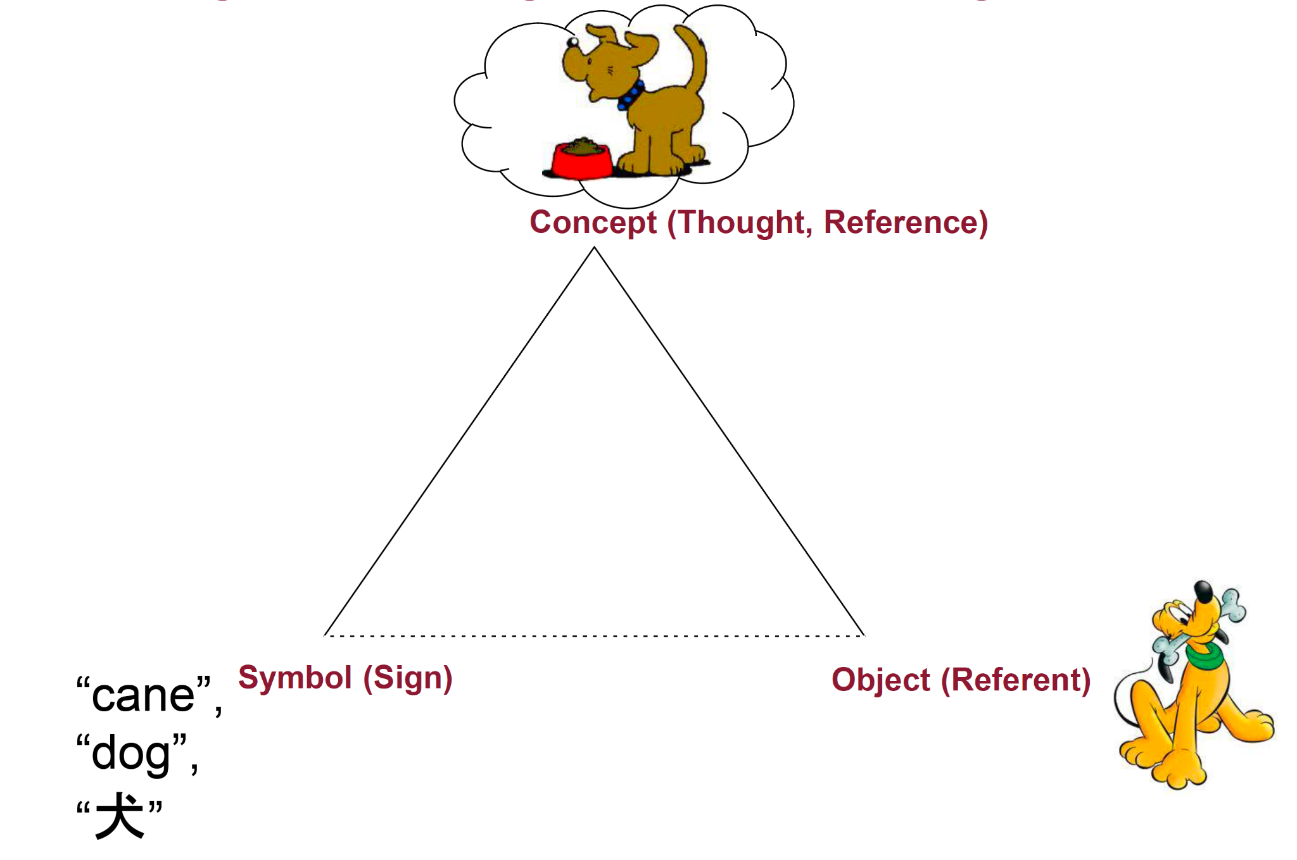
Semantics: Semiotic Triangle (Triangle of meaning)
[Ogden&Richards, 1923]
Natural Language Processing - 1.10 Semantics

Slide 5
Semantics: Semiotic Triangle (Triangle of meaning)
The triangle of meaning is a model of communication that indicates the relationship among a thought, symbol, and referent, and highlights the indirect relationship between the symbol and the referent. The model explains how for any given symbol there can be many different referents, which can lead to misunderstanding.
[Ogden&Richards, 1923]
Natural Language Processing - 1.10 Semantics

Slide 6
From Syntax to Semantics
We are now moving from syntax to semantics:
Book the dinner flight
Natural Language Processing - 1.10 Semantics

Slide 7
From Syntax to Semantics
We are now moving from syntax to semantics:
Book the dinner flight
Natural Language Processing - 1.10 Semantics

Slide 8


From Syntax to Semantics
We are now moving from syntax to semantics:
Book the dinner flight
?
What is the correct semiotic triangle for the word book in this context? -> What is the semantics (the word meaning) for the word book in this context.
Natural Language Processing - 1.10 Semantics

Slide 9
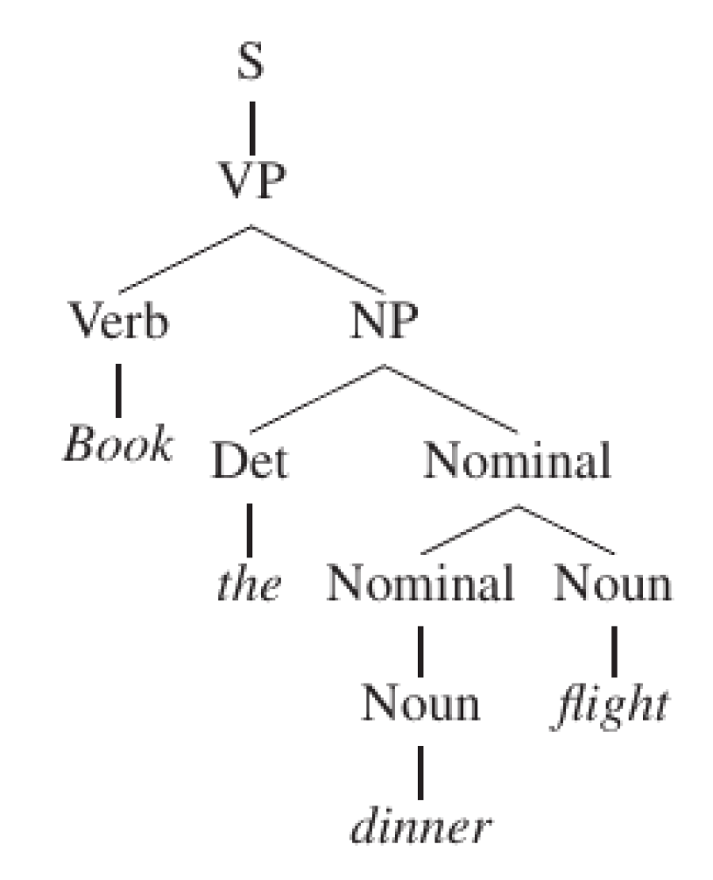
From Syntax to Semantics
We are now moving from syntax to semantics:
Book the dinner flight
we can understand that, in this context, book is a Verb
Natural Language Processing - 1.10 Semantics

Slide 10
From Syntax to Semantics
We are now moving from syntax to semantics:
if we have a sense inventory
Book the dinner flight
Verb
S: (v) book (engage for a performance) "Her agent had booked her for several concerts in Tokyo"
S: (v) reserve, hold, book (arrange for and reserve (something for someone else) in advance) "reserve me a seat on a flight"; "The agent booked tickets to the show for the whole family"; "please hold a table at Maxim's"
S: (v) book (record a charge in a police register) "The policeman booked her when she tried to solicit a man"
S: (v) book (register in a hotel booker)
Natural Language Processing - 1.10 Semantics

Slide 11
From Syntax to Semantics
We are now moving from syntax to semantics:
if we have a sense inventory
Book the dinner flight
Verb
S: (v) book (engage for a performance) "Her agent had booked her for several concerts in Tokyo"
S: (v) reserve, hold, book (arrange for and reserve (something for someone else) in advance) "reserve me a seat on a flight"; "The agent booked tickets to the show for the whole family"; "please hold a table at Maxim's"
S: (v) book (record a charge in a police register) "The policeman booked her when she tried to solicit a man"
S: (v) book (register in a hotel booker)
?
it is a challenging problem to understand the meaning of words in context!
Natural Language Processing - 1.10 Semantics

Slide 12
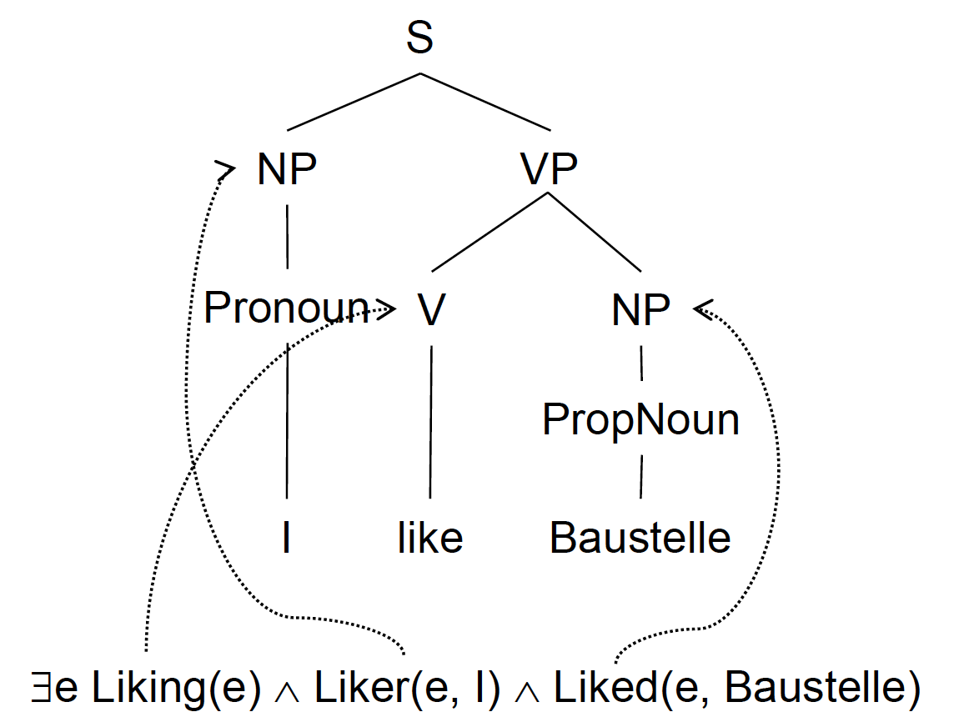
Syntax-driven semantic analysis: Semantic Attachments
We start from a simplified kind of semantic analysis driven by syntax
–Very complex to use in the real world. Why?
•Example: “I like Baustelle”
Natural Language Processing - 1.10 Semantics

Slide 13
Syntax-driven semantic analysis: Semantic Attachments
The assumption here is that we have enough knowledge about this specific example and its parse tree.
But there is an infinite number of such examples and parse trees!
Natural Language Processing - 1.10 Semantics

Slide 14
Syntax-driven semantic analysis: Semantic Attachments
We already faced this problem!
E.g., To encode a language, we do not enumerate the strings in the language
•We use a finite formalism that can be used to generate all the strings in the language
•We can do the same for semantics and attach meaning to productions
–Rule-to-rule hypothesis
Natural Language Processing - 1.10 Semantics

Slide 15
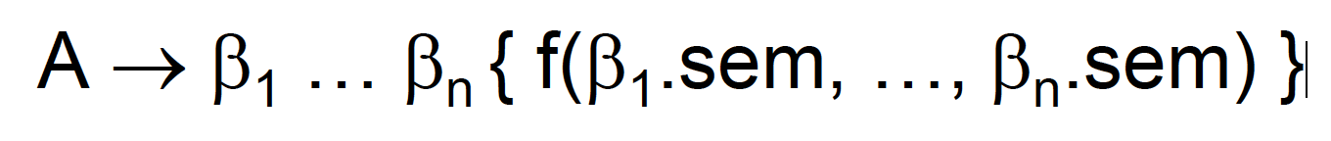
Syntax-driven semantic analysis: Semantic Attachments
We can augment CFGs with semantic attachments:
Natural Language Processing - 1.10 Semantics

Slide 16
Syntax-driven semantic analysis: Semantic Attachments
We can augment CFGs with semantic attachments:
What can we attach to our context-free rules?
•Our function f could be a program fragment
– The semantic interpretation would be obtained as a result of the bottom-up execution of such fragments
– Semantic results would be stored for each non-terminal
–Remember Lex and Yacc?
•But:
– We cannot (immediately) use logical expressions
– How can we design grammars with such programs?
Natural Language Processing - 1.10 Semantics

Slide 17
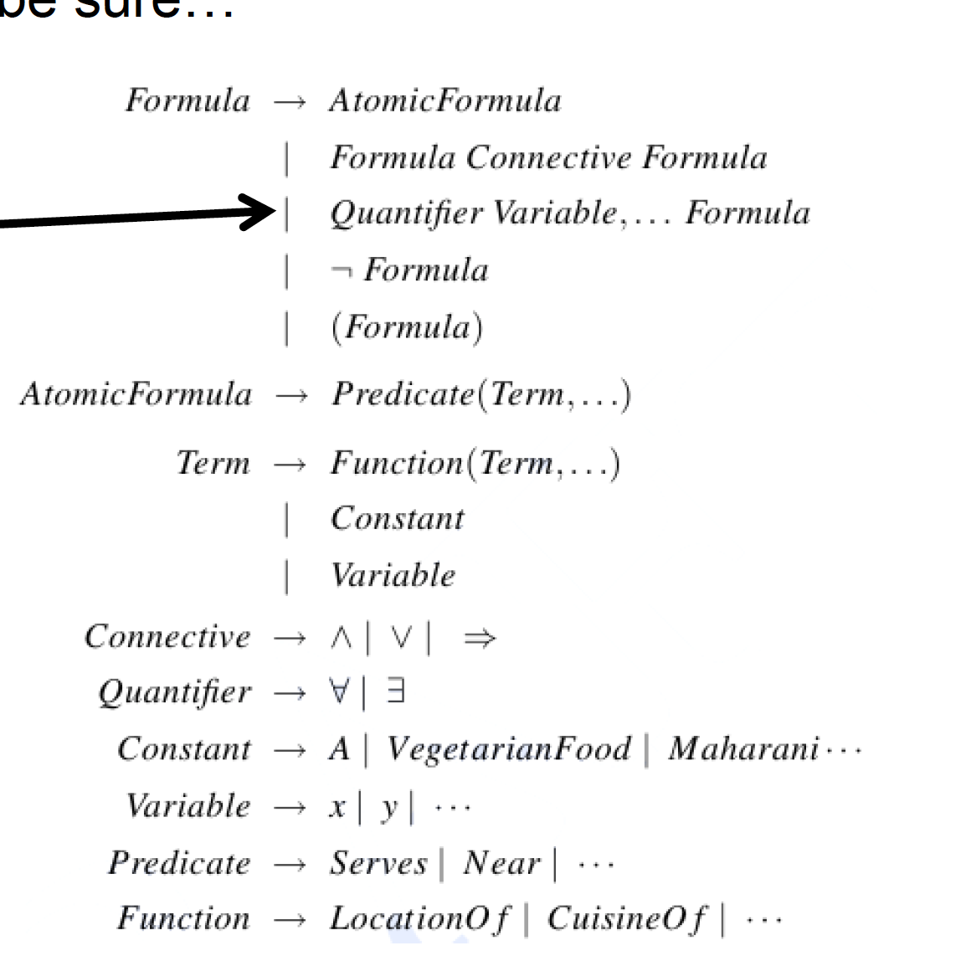
Syntax-driven semantic analysis: Semantic Attachments
One option is to adopt First-Order Logic (FOL),
you all know what it is…but just to be sure…
Natural Language Processing - 1.10 Semantics

Slide 18
Syntax-driven semantic analysis: Semantic Attachments
With such a First-Order Logic (FOL) specification we can express facts in the following form:
Le Scalette’s location is Nemi
LocationOf(LeScalette, Nemi)
Le Scalette is a restaurant and Le Scalette’s location is Nemi
Restaurant(LeScalette) Λ LocationOf(LeScalette, Nemi)
There exists a restaurant in Nemi?
ヨx Restaurant(x) Λ LocationOf(x, Nemi)
All pizzerias serve pizzas
∀x Pizzeria(x) ⇒ Serves(x, Pizza)
Natural Language Processing - 1.10 Semantics

Slide 19
Syntax-driven semantic analysis: Semantic Attachments
In order to abstract away from fully specified FOL, we can use the lambda notation
It extends the syntax of FOL to include expressions of the form:
λx.P(x)
You can apply these expressions to other logical terms to yield new FOL expressions
– For instance: (λx.Restaurant(x))(LeScalette) -> Restaurant(LeScalette)
This operation is called beta reduction
Natural Language Processing - 1.10 Semantics

Slide 20
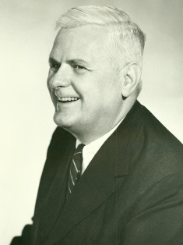
Lambda Calculus
Lambda Calculus consists of lambda terms:
– Variables: A variable x is a lambda term
– Abstraction: If t is a lambda term and x a variable, λx.t is a lambda term:
λx represents an anonymous function with a given input x
λ binds x in t
– Application:if t and s are lambda terms, then ts is a lambda term
Alonzo Church, 1930s
…and extra operations:
– Alpha conversion: bound variables can be renamed
– Beta reduction:an application of the form (λx.t)s reduces to the term t[x := s]
Natural Language Processing - 1.10 Semantics

Slide 21
Lambda Calculus: examples
•Identity: λx.x
•Constant: λx.y
•Square function: λx.x*x
What is the square of 4? (λx.x*x) 4 = 4*4
• Multiple-argument functions: λx.λy.x*y
Natural Language Processing - 1.10 Semantics

Slide 22
Lambda Calculus: Linguistic examples
We need constants to build phrases:
two, red, loves, ate, John, Mary, etc.
Connectives and quantifiers:
or, and, not, if … then, for all, there exists
Examples:
loves(John, Mary)
ヨ m.mozzarella(m) Λ ate(John, m)
ヨ m.mozzarella(m) Λ blue(m) Λ ate(John, m)
Natural Language Processing - 1.10 Semantics

Slide 23
Lambda Calculus: modelings events
If something happens in a specific moment or period of time, we have an event.
Example:
ヨe.past(e) Λ act(e, eating) Λ eater(e, John) Λ ヨm (mozzarella(m) Λ eatee(e, m))
Natural Language Processing - 1.10 Semantics

Slide 24

How to Get Semantics from sentences
Parse sentences into parse trees
Get the semantics for each word
Use the parse tree to build the semantics bottom-up (from words to more complex constituents)
Natural Language Processing - 1.10 Semantics

Slide 25
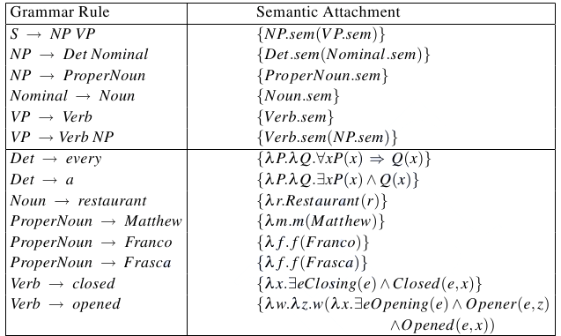
An example excerpt
Natural Language Processing - 1.10 Semantics

Slide 26
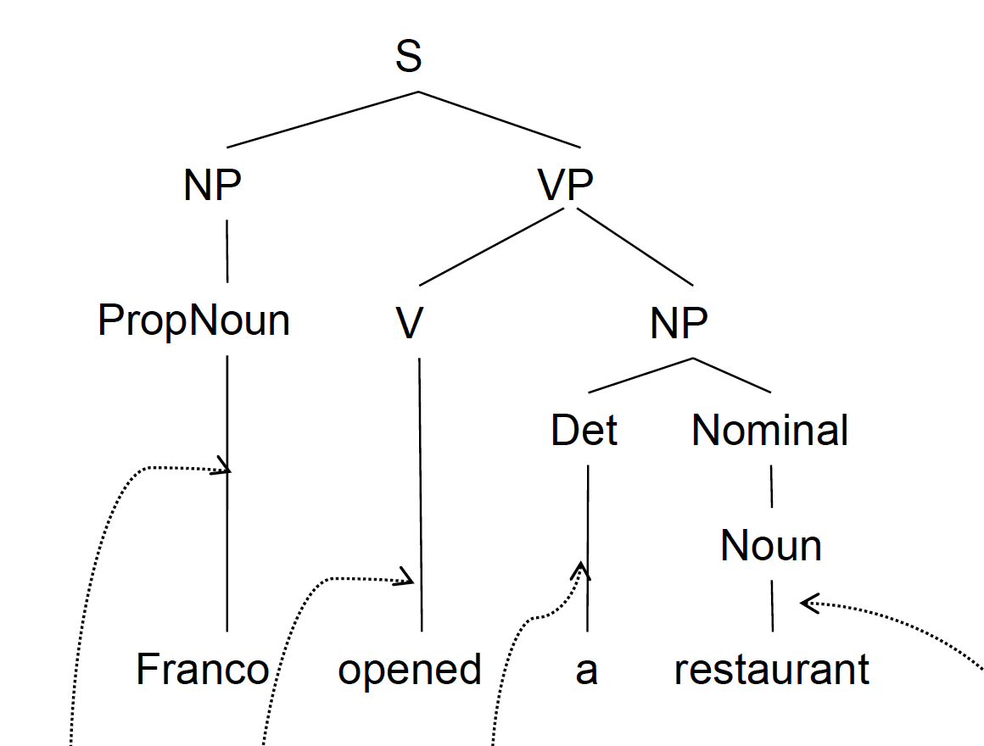

An example excerpt
Franco opened a restaurant
Natural Language Processing - 1.10 Semantics

Slide 27
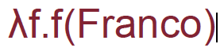
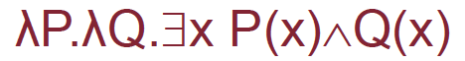
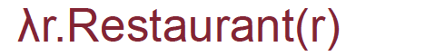
An example excerpt
Franco opened a restaurant
Natural Language Processing - 1.10 Semantics

Slide 28
An example excerpt
Franco opened a restaurant
(λP.λQ.x P(x)Q(x)) λr.Restaurant(r))
=λQ.x Restaurant(x)Q(x)
Beta-reduction
Natural Language Processing - 1.10 Semantics

Slide 29
An example excerpt
Franco opened a restaurant
(λP.λQ.x P(x)Q(x)) λr.Restaurant(r))
=λQ.x Restaurant(x)Q(x)
Beta-reduction
and so on …
Natural Language Processing - 1.10 Semantics

Slide 30
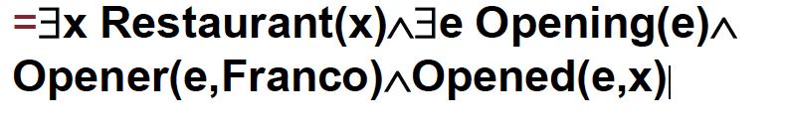
An example excerpt
(λP.λQ.x P(x)Q(x)) λr.Restaurant(r))
=λQ.x Restaurant(x)Q(x)
Sentence:
Franco opened a restaurant
Semantics:
Natural Language Processing - 1.10 Semantics

Slide 31
Side-effects
It’s difficult!
Natural Language Processing - 1.10 Semantics

Slide 32
Side-effects
It’s difficult!
More dangerous:
We made a simplifying assumption that each terminal (e.g., Opening, Franco, etc.) represents one meaning!
Natural Language Processing - 1.10 Semantics

Slide 33

Side-effects
It’s difficult!
More dangerous:
We made a simplifying assumption that each terminal (e.g., Opening, Franco, etc.) represents one meaning!
Natural Language Processing - 1.10 Semantics

Slide 34
Side-effects
It’s difficult!
More dangerous:
We made a simplifying assumption that each terminal (e.g., Opening, Franco, etc.) represents one meaning!
We need to step back to the meaning of words before trying to cope with the meaning of sentences.
Lexical-semantics
Natural Language Processing - 1.10 Semantics

Slide 35
Lexical-semantics
We need to step back to the meaning of words before trying to cope with the meaning of sentences.
Some definitions:
– Lexicon: a finite list of given language words
– Lemma: the grammatical base form used in dictionaries
(e.g., peach is the lemma of peaches)
– Word form: any grammatical form of a word
(e.g. eat, eats, ate, etc.)
Natural Language Processing - 1.10 Semantics

Slide 36
Lexical-semantics: lemmatization
The process of converting word forms to their lemmas is called lemmatization
•Not always deterministic, it may depend on the context
– It bound the parties to observe neutrality
•Lemma: bind (constrain)
– The horses were found to bound across the meadows
•Lemma: bound (jumping)
•Plus: lemmas are different across parts of speech:
– They closed the purchase with a handshake
– They are about to purchase a flat
Natural Language Processing - 1.10 Semantics

Slide 37
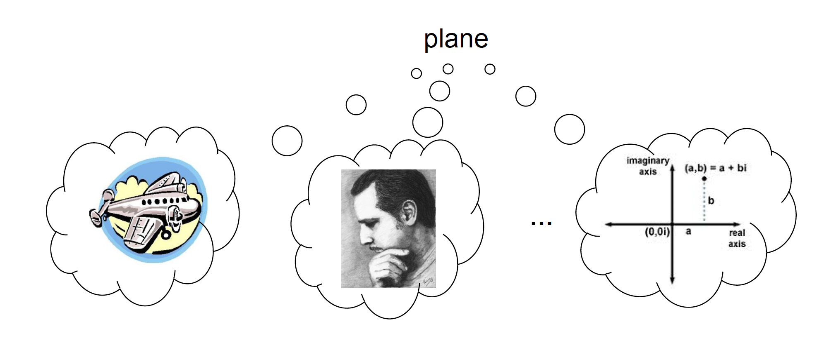
Word Senses
The meaning of a word depends on the context in which it occurs.
We call each meaning of a word a word sense.
Natural Language Processing - 1.10 Semantics

Slide 38
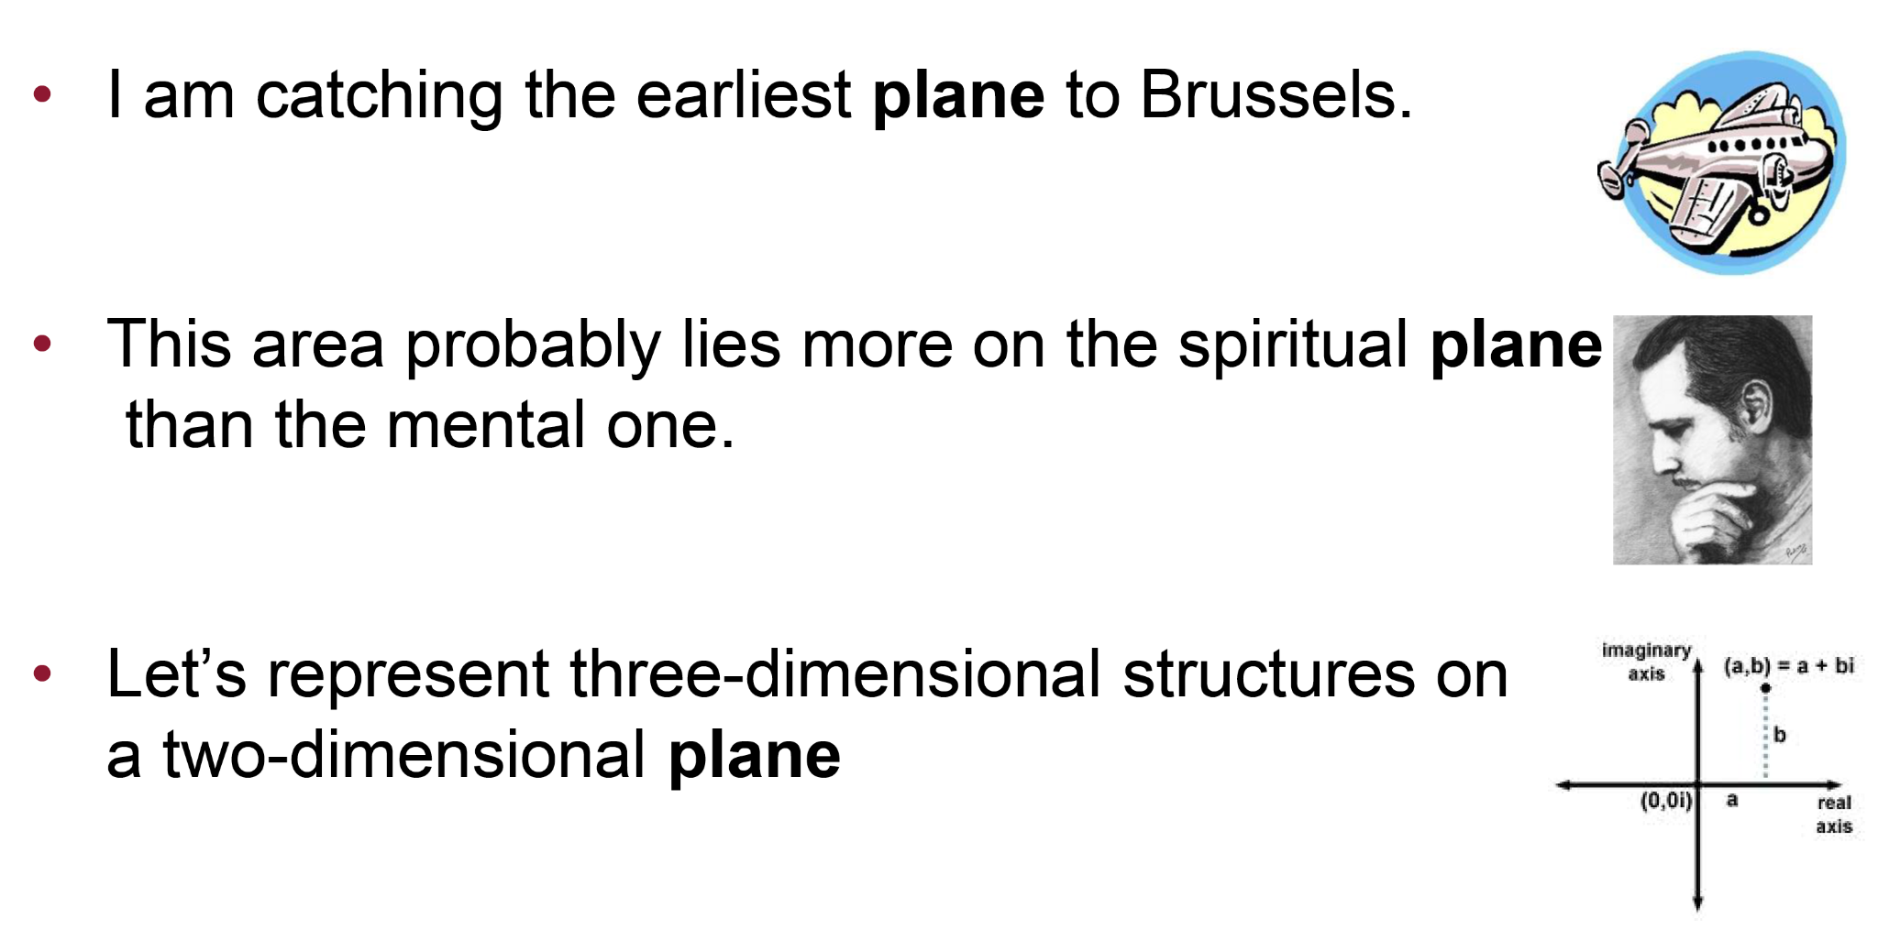
Word Senses in context: the “plane” example
Natural Language Processing - 1.10 Semantics

Slide 39
Monosemy vs. Polysemy
A word is monosemous if it has a single sense
– Internet
– plant life
– …
Polysemous otherwise
– bank
– plane
– bass
– …
Natural Language Processing - 1.10 Semantics

Slide 40



How do state-of-the-art applications deal with senses?
Natural Language Processing - 1.10 Semantics

Slide 41
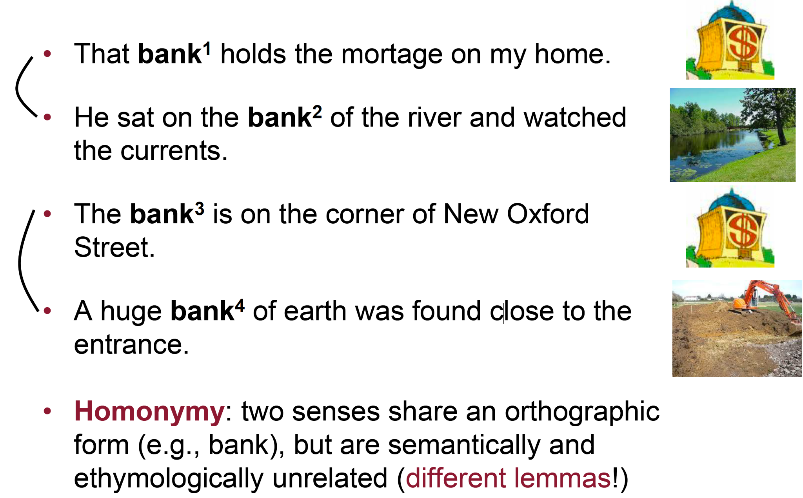
Homonymy
Natural Language Processing - 1.10 Semantics

Slide 42
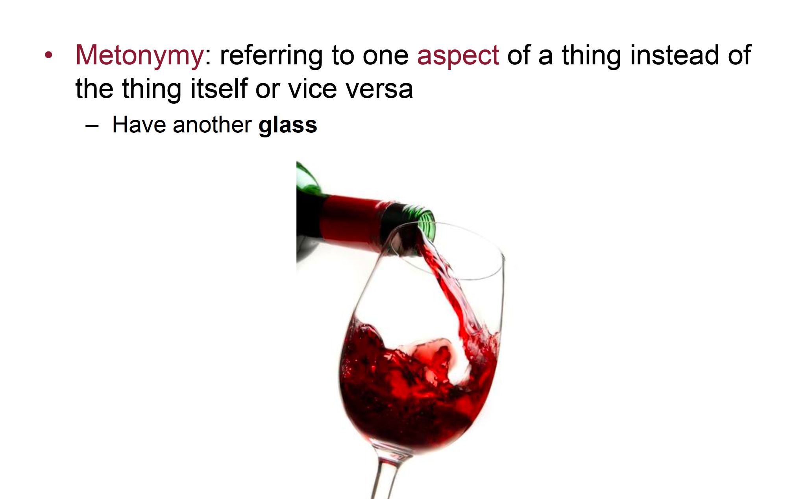
Metonymy
Natural Language Processing - 1.10 Semantics

Slide 43
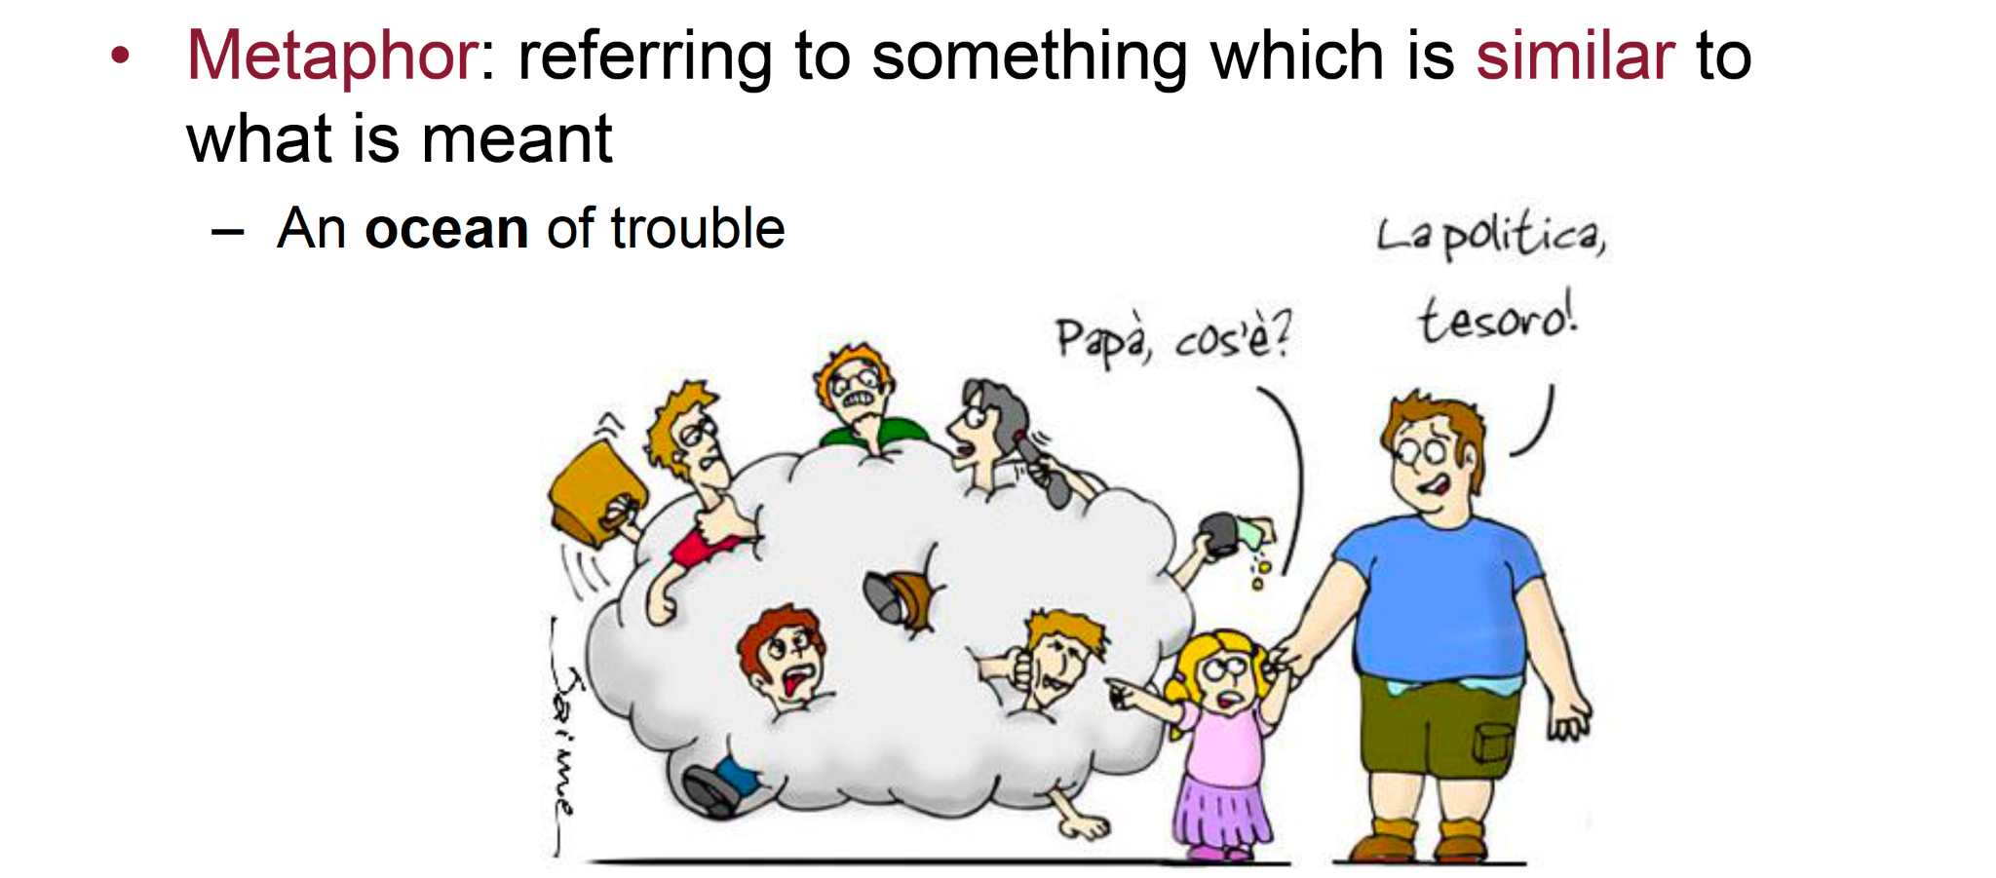
Metaphor
Politics,
darling!
Dad, what is it?
Natural Language Processing - 1.10 Semantics

Slide 44
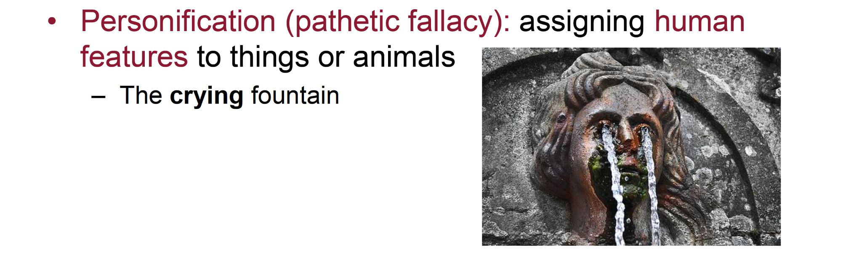
Personification
Natural Language Processing - 1.10 Semantics

Slide 45
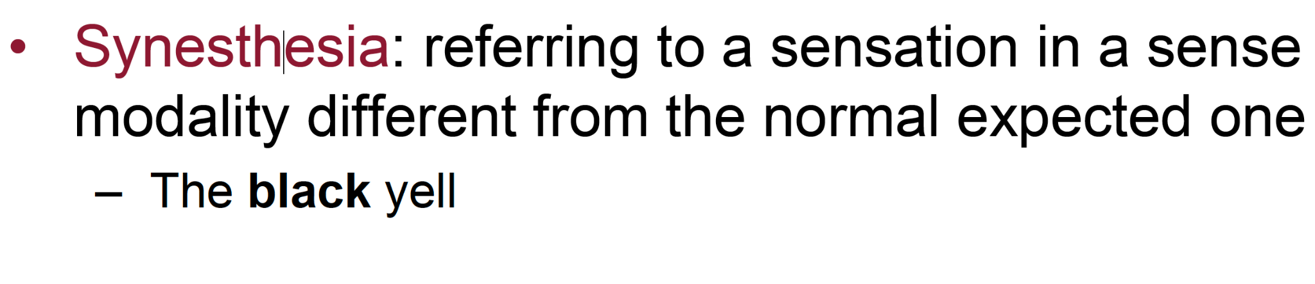

Synesthesia
Natural Language Processing - 1.10 Semantics

Slide 46
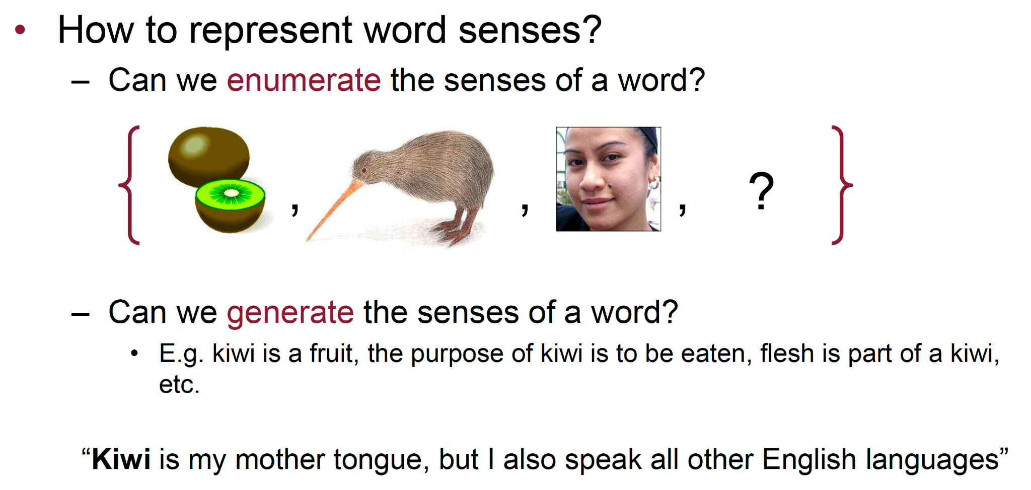
Sense Distinctions
The problem is about the word sense representation:
Natural Language Processing - 1.10 Semantics

Slide 47
Word Senses: the enumerative approach
A fixed sense inventory enumerates the range of all possible meanings of a word.
Natural Language Processing - 1.10 Semantics

Slide 48
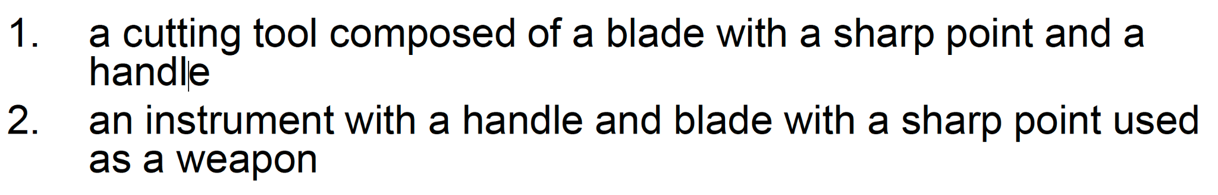
Word Senses: the enumerative approach
A fixed sense inventory enumerates the range of all possible meanings of a word.
Example: knife
Natural Language Processing - 1.10 Semantics

Slide 49
Word Senses: the enumerative approach
A fixed sense inventory enumerates the range of all possible meanings of a word.
Example: knife
Words in context are assumed to select/activate one of these senses in each context
Natural Language Processing - 1.10 Semantics

Slide 50
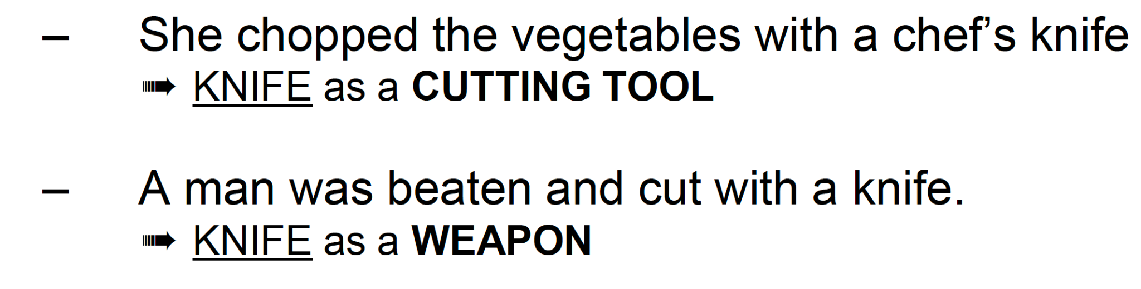
Word Senses: the enumerative approach
A fixed sense inventory enumerates the range of all possible meanings of a word.
Example: knife
Words in context are assumed to select/activate one of these senses in each context
Natural Language Processing - 1.10 Semantics

Slide 51
Word Senses: the enumerative approach
A fixed sense inventory enumerates the range of all possible meanings of a word.
Example: knife
? should we add a further sense to the inventory for “a cutting blade forming part of a machine”
? are word senses application-independent
Natural Language Processing - 1.10 Semantics

Slide 52
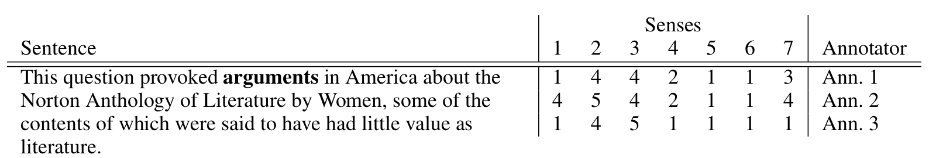
Graded word sense assignment [Erk and McCarthy, 2009]
Similar to category membership in the human mind, the meanings of words in context do not always have clear-cut boundaries
Given a target word, annotators judge the applicability of each possible word sense on a graded scale
Natural Language Processing - 1.10 Semantics

Slide 53
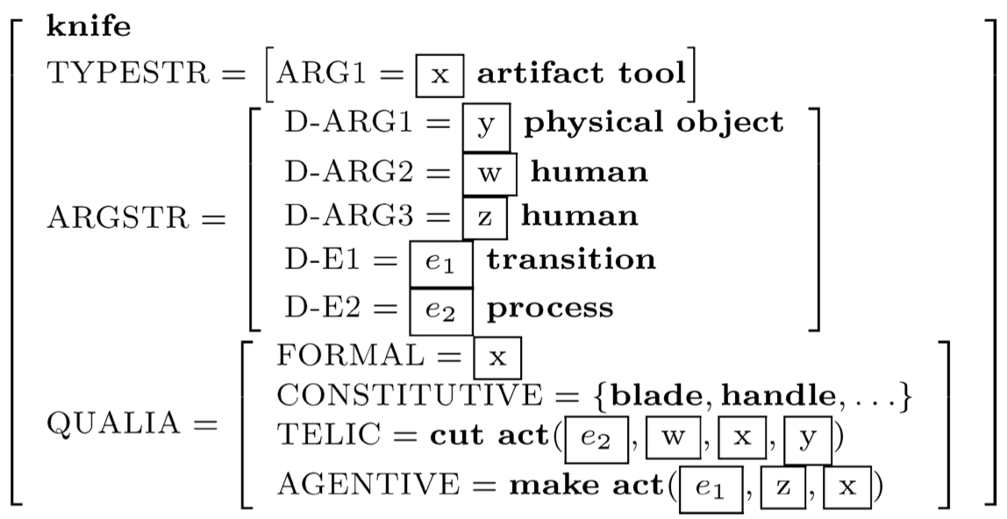
Word Senses: the Generative Approach [Pustejovsky, 1991]
Senses are generated from rules which capture regularities in the creation of senses
Qualia structures are the roles describing the meaning of a lexical element:
– FORMAL: distinguishes a word within a larger domain typing information about the object (e.g., hypernym)
– CONSTITUTIVE: physical properties of a object (e.g., material, parts)
– TELIC: the object’s purpose and function
– AGENTIVE: the object’s origin or “bringing about”, typically a verb denoting an action which brings the object in existence
Natural Language Processing - 1.10 Semantics

Slide 54
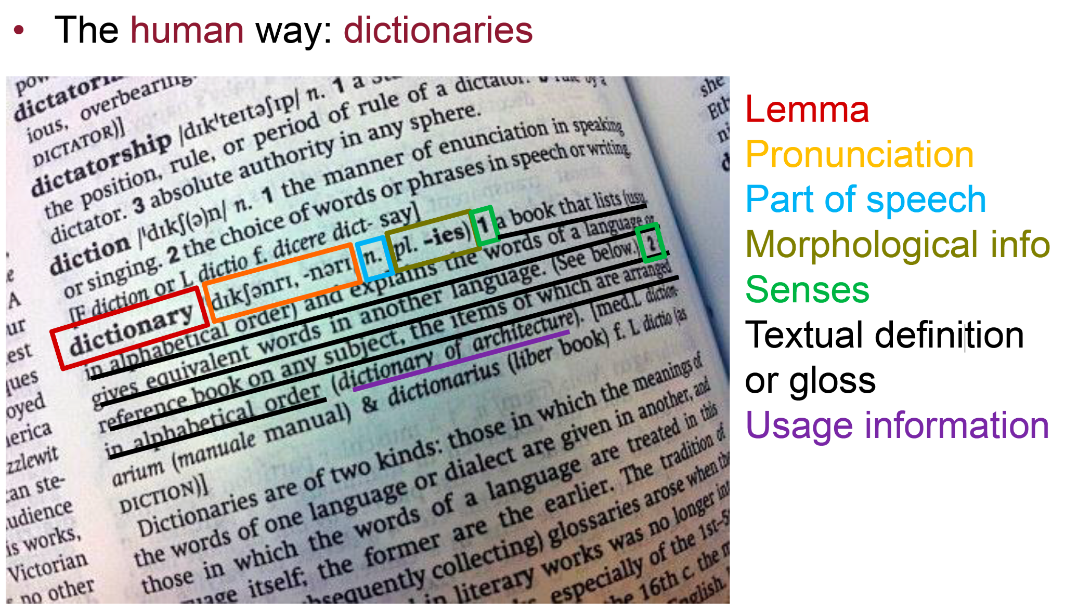
How do we encode word senses?
Natural Language Processing - 1.10 Semantics

Slide 55
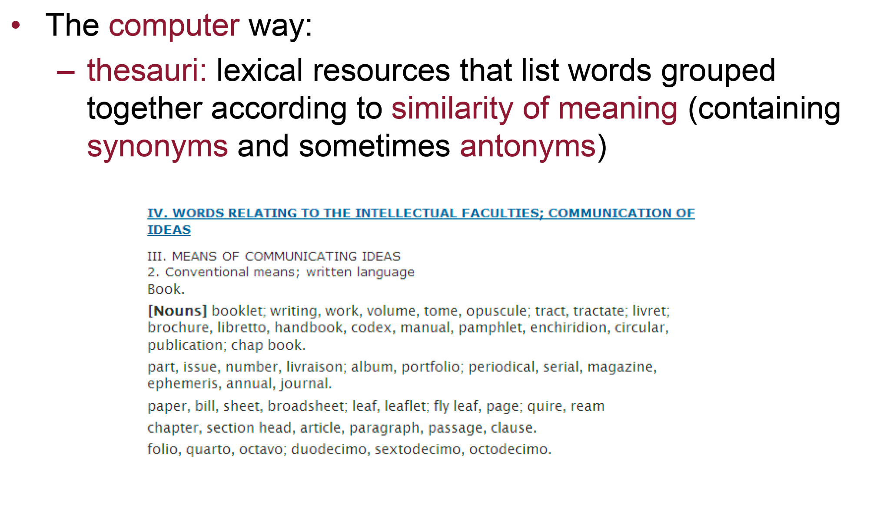
How do we encode word senses?
Natural Language Processing - 1.10 Semantics

Slide 56
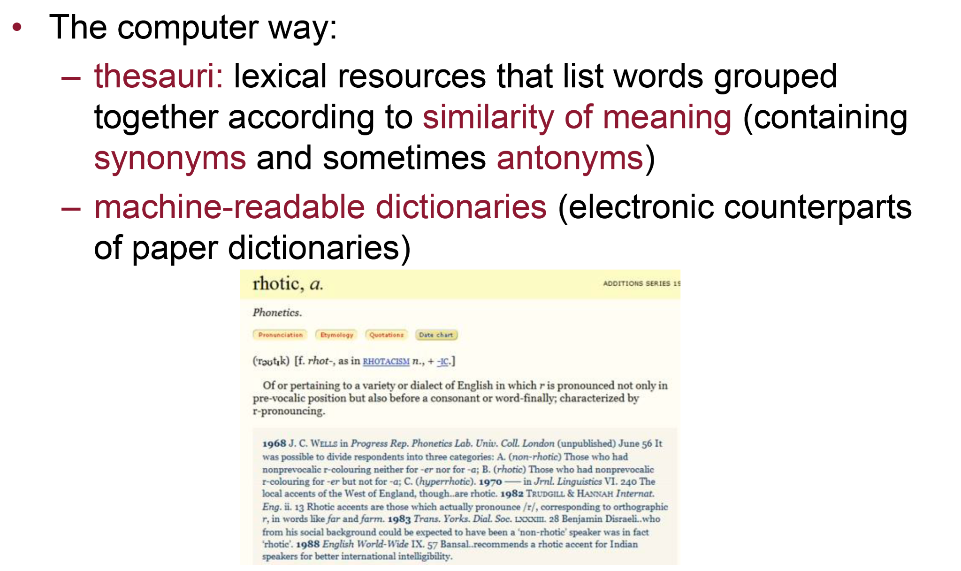
How do we encode word senses?
Natural Language Processing - 1.10 Semantics

Slide 57
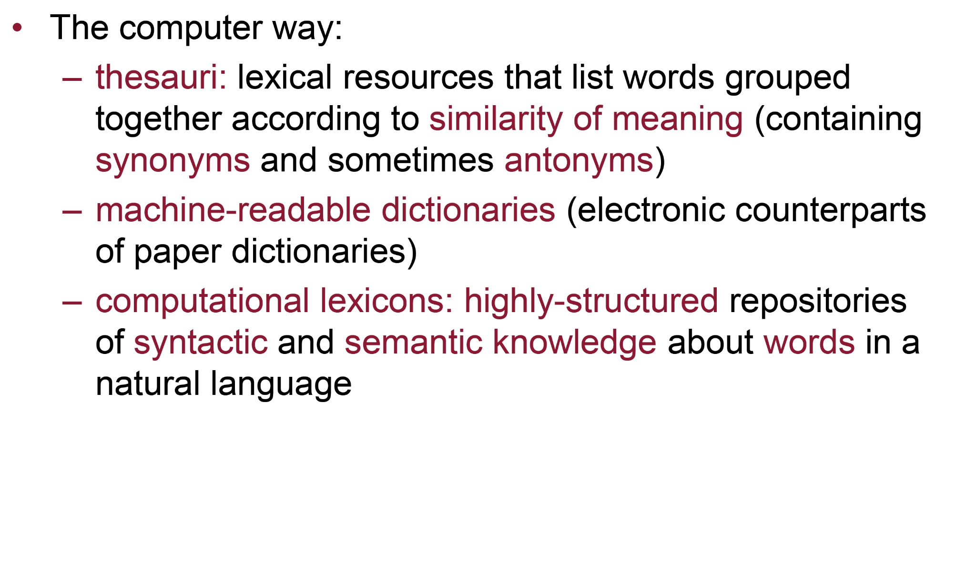
How do we encode word senses?
Natural Language Processing - 1.10 Semantics

Slide 58
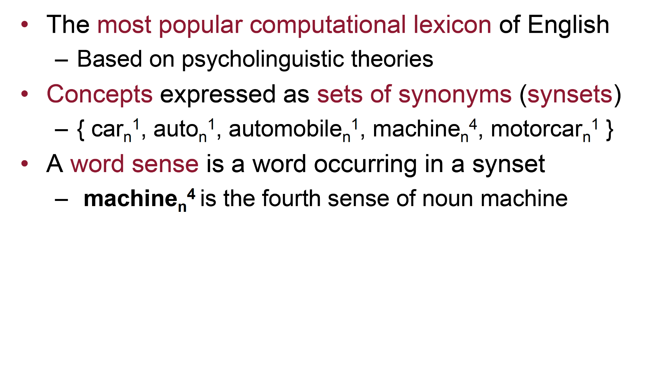
WordNet [Miller et al. 1990]
Natural Language Processing - 1.10 Semantics

Slide 59
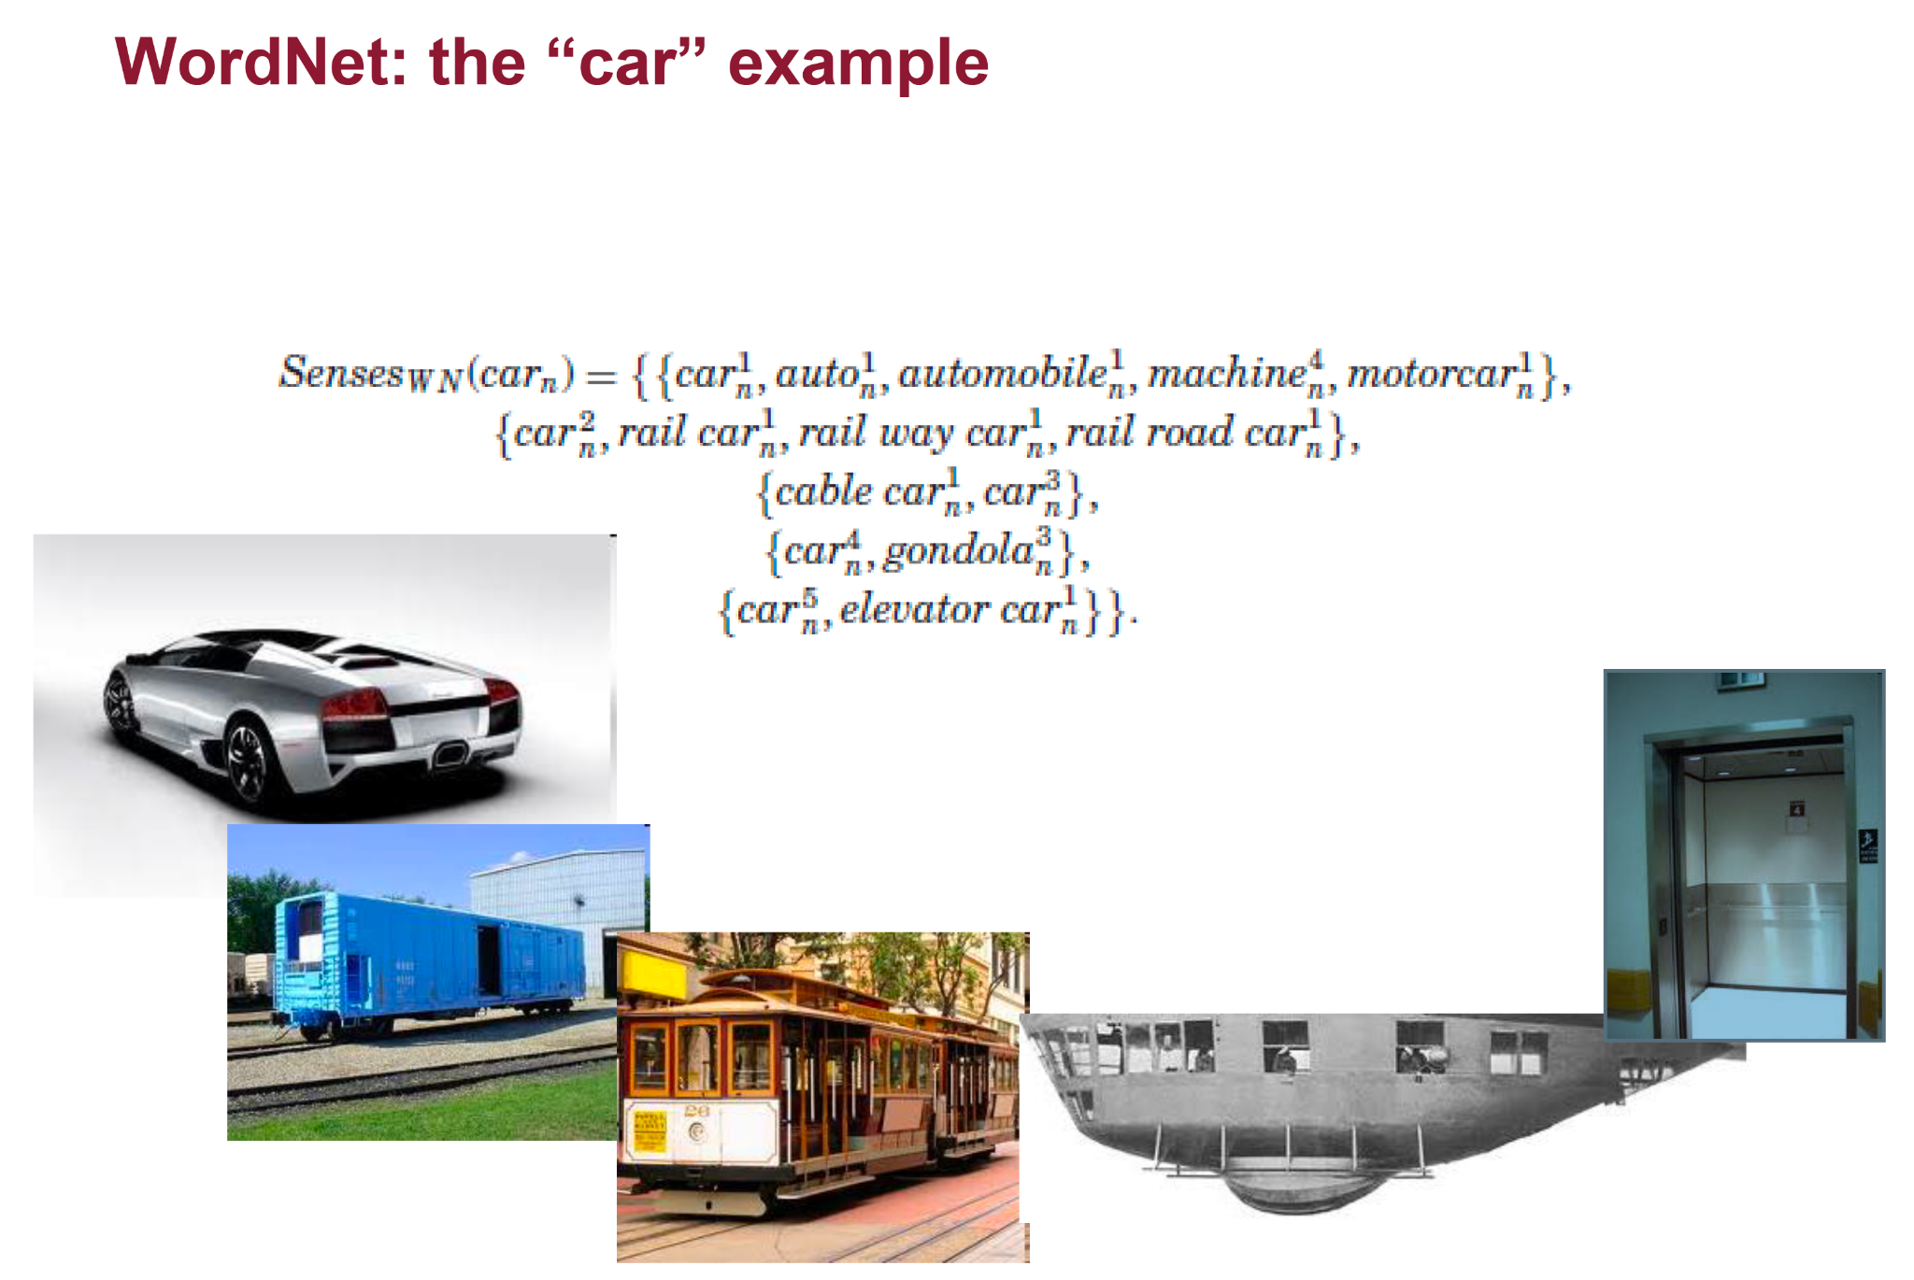
WordNet [Miller et al. 1990]
Natural Language Processing - 1.10 Semantics

Slide 60
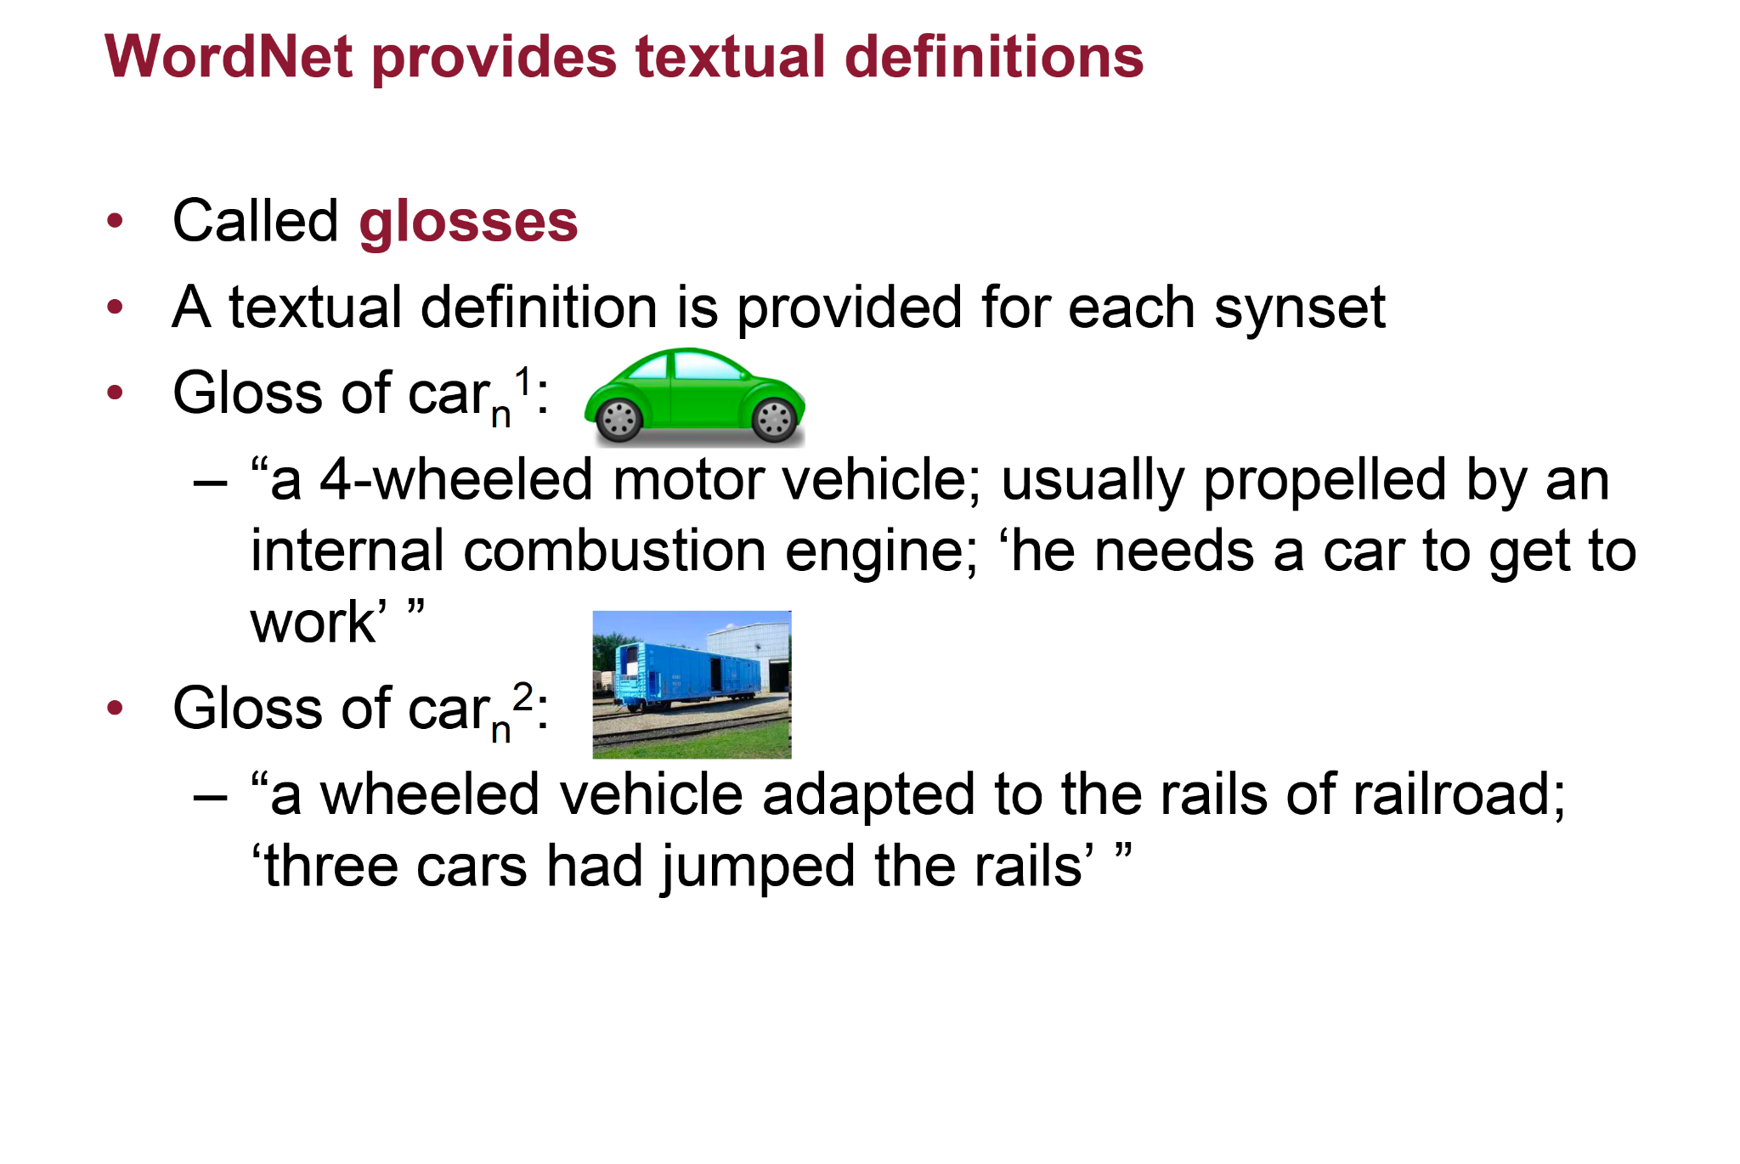
WordNet [Miller et al. 1990]
Natural Language Processing - 1.10 Semantics

Slide 61
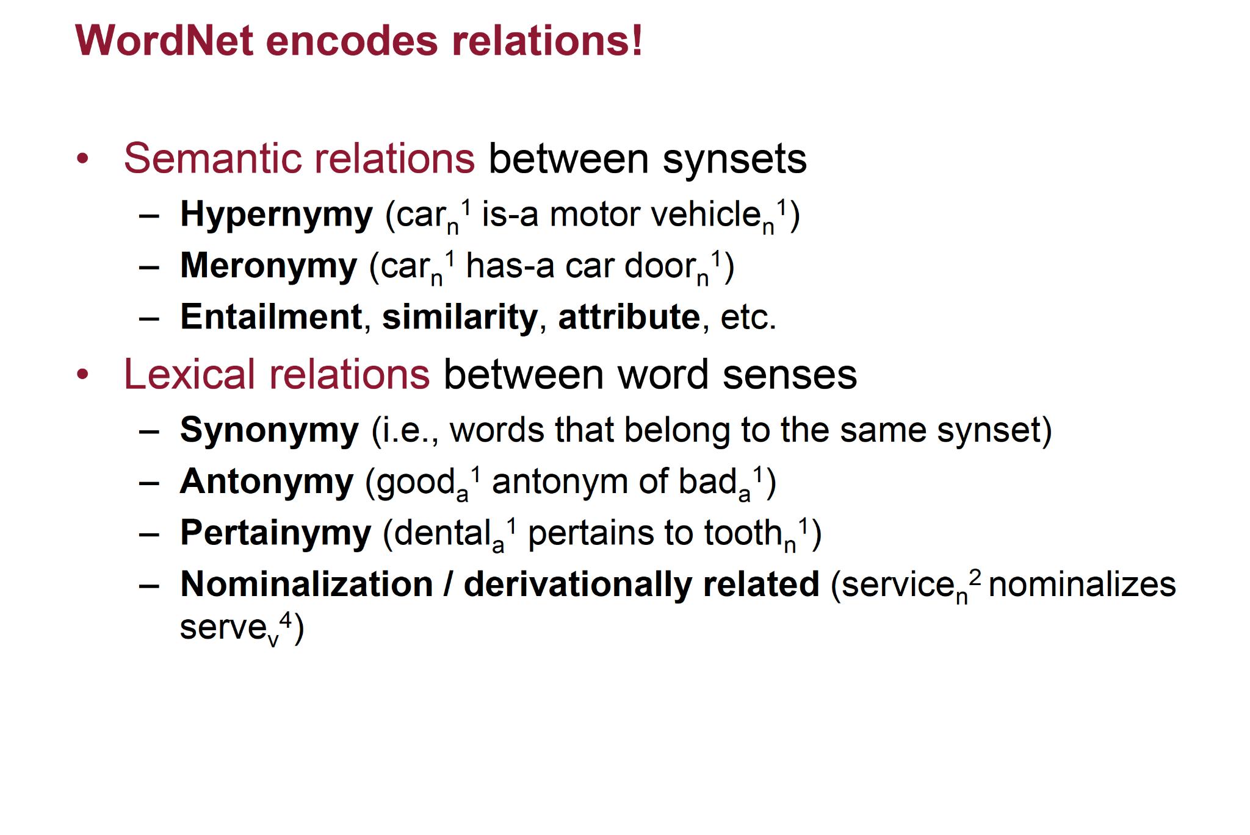
WordNet [Miller et al. 1990]
Natural Language Processing - 1.10 Semantics

Slide 62
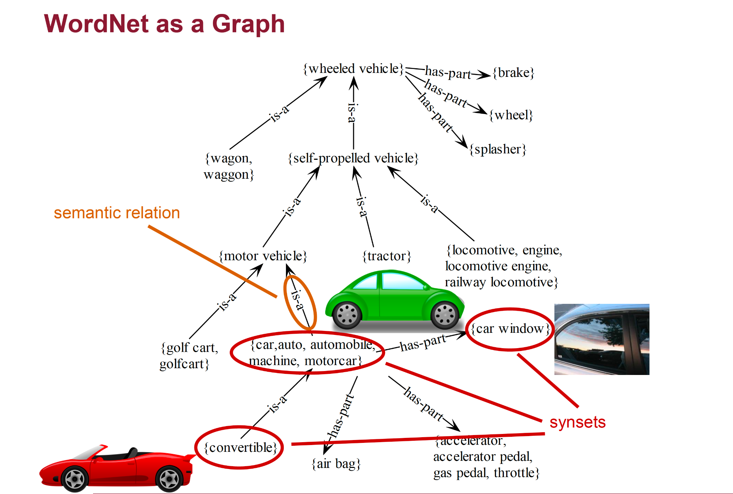
WordNet [Miller et al. 1990]
Natural Language Processing - 1.10 Semantics

Slide 63
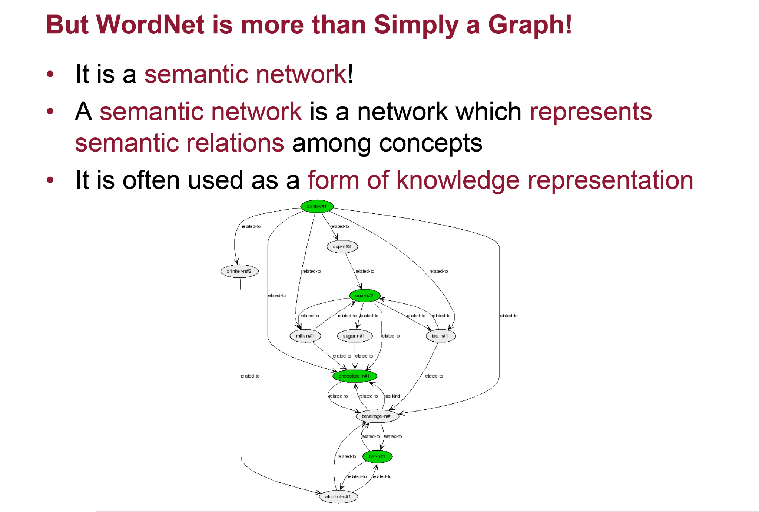
WordNet [Miller et al. 1990]
Natural Language Processing - 1.10 Semantics

Slide 64
WordNet [Miller et al. 1990]
https://wordnet.princeton.edu/
There are several API to programmatically leverage WordNet in your programs.
Java: (e.g., https://projects.csail.mit.edu/jwi/)
Python: (e.g., https://www.nltk.org/)
...
Natural Language Processing - 1.10 Semantics

Slide 65
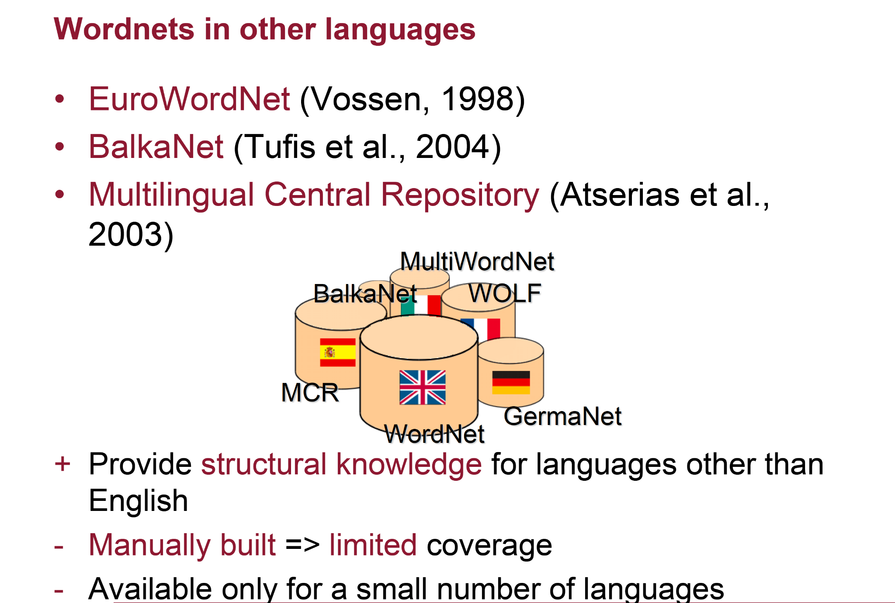
WordNet [Miller et al. 1990]
[Vossen, 1998]
[Tufis et al., 2004]
[Atserias et al., 2003]
Natural Language Processing - 1.10 Semantics

Slide 66
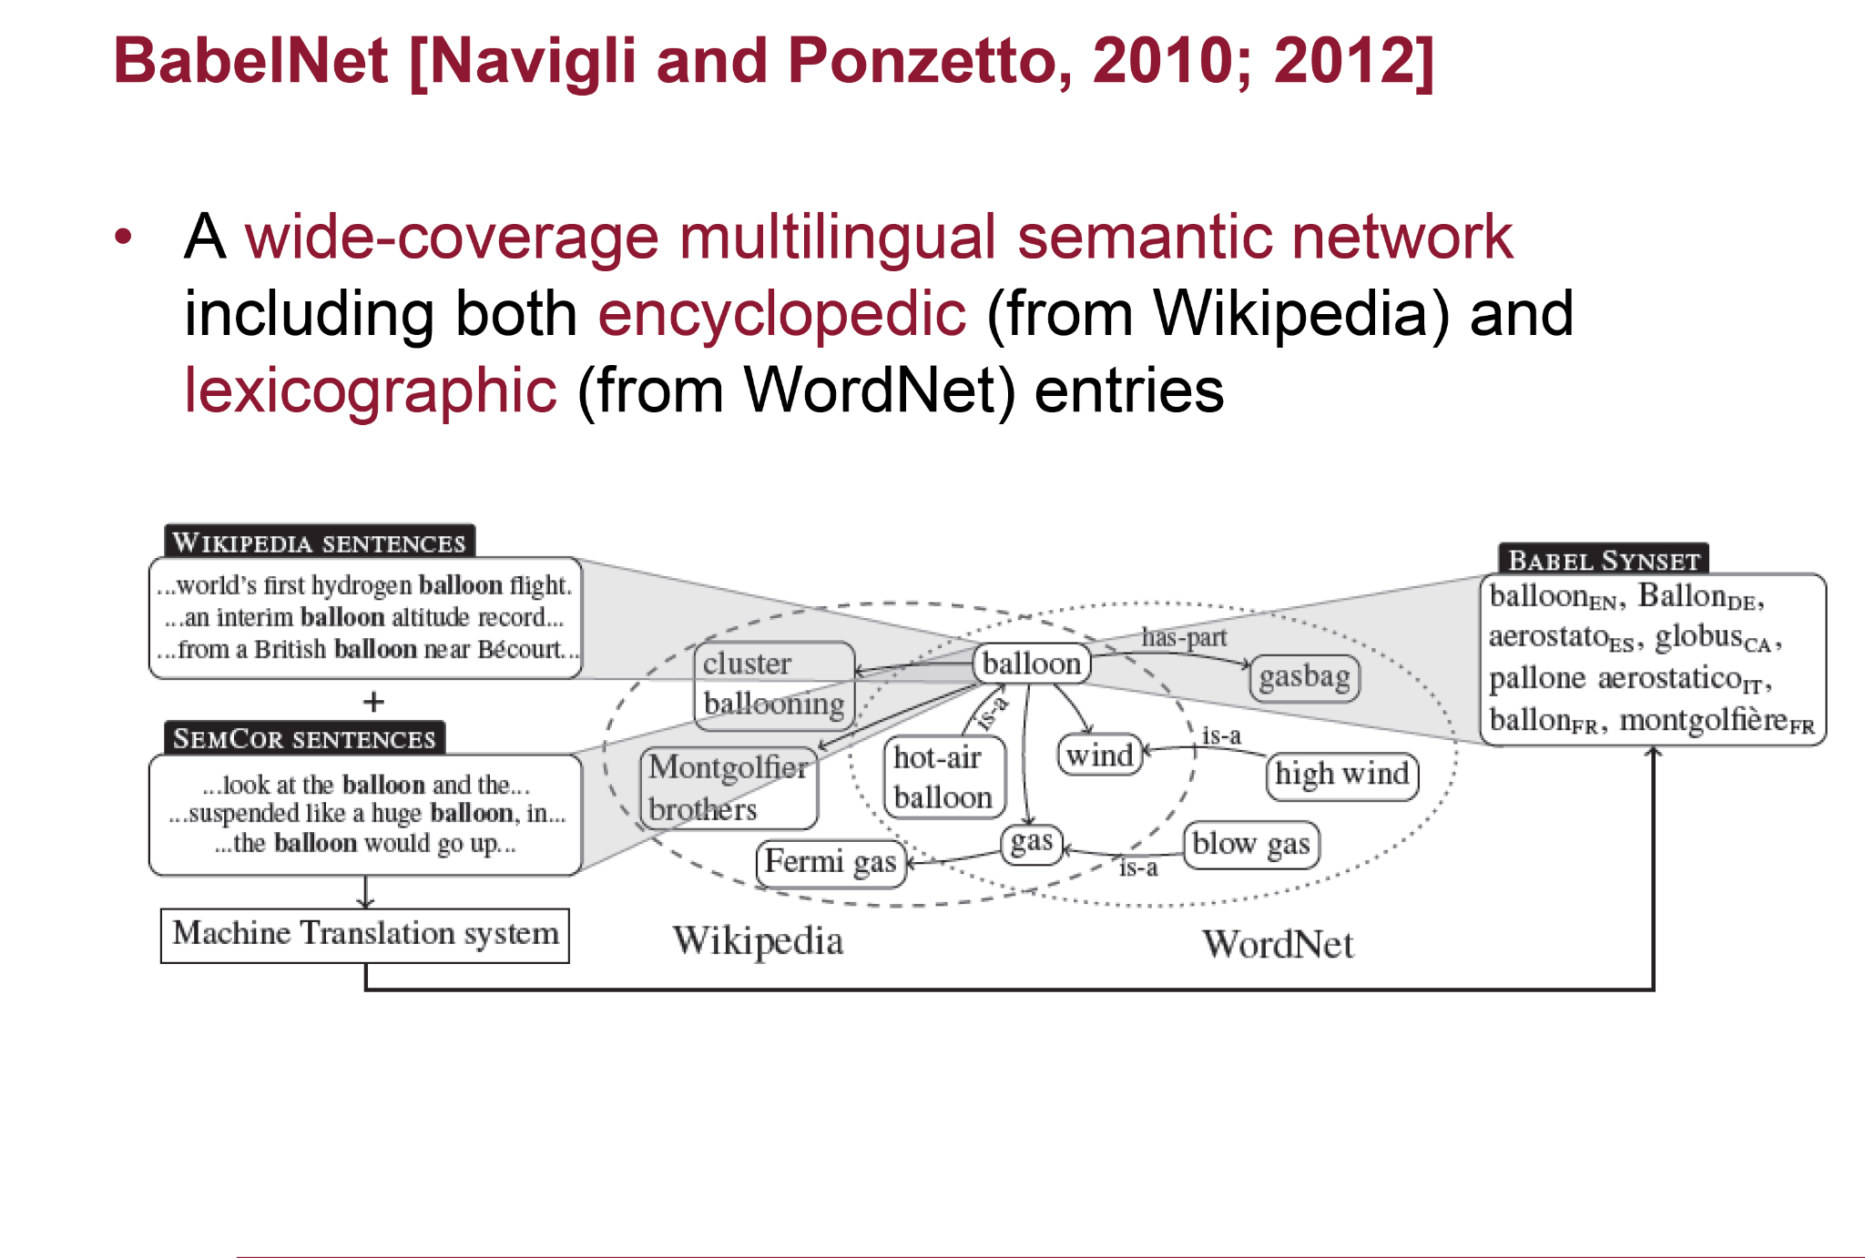
Natural Language Processing - 1.10 Semantics

Slide 67
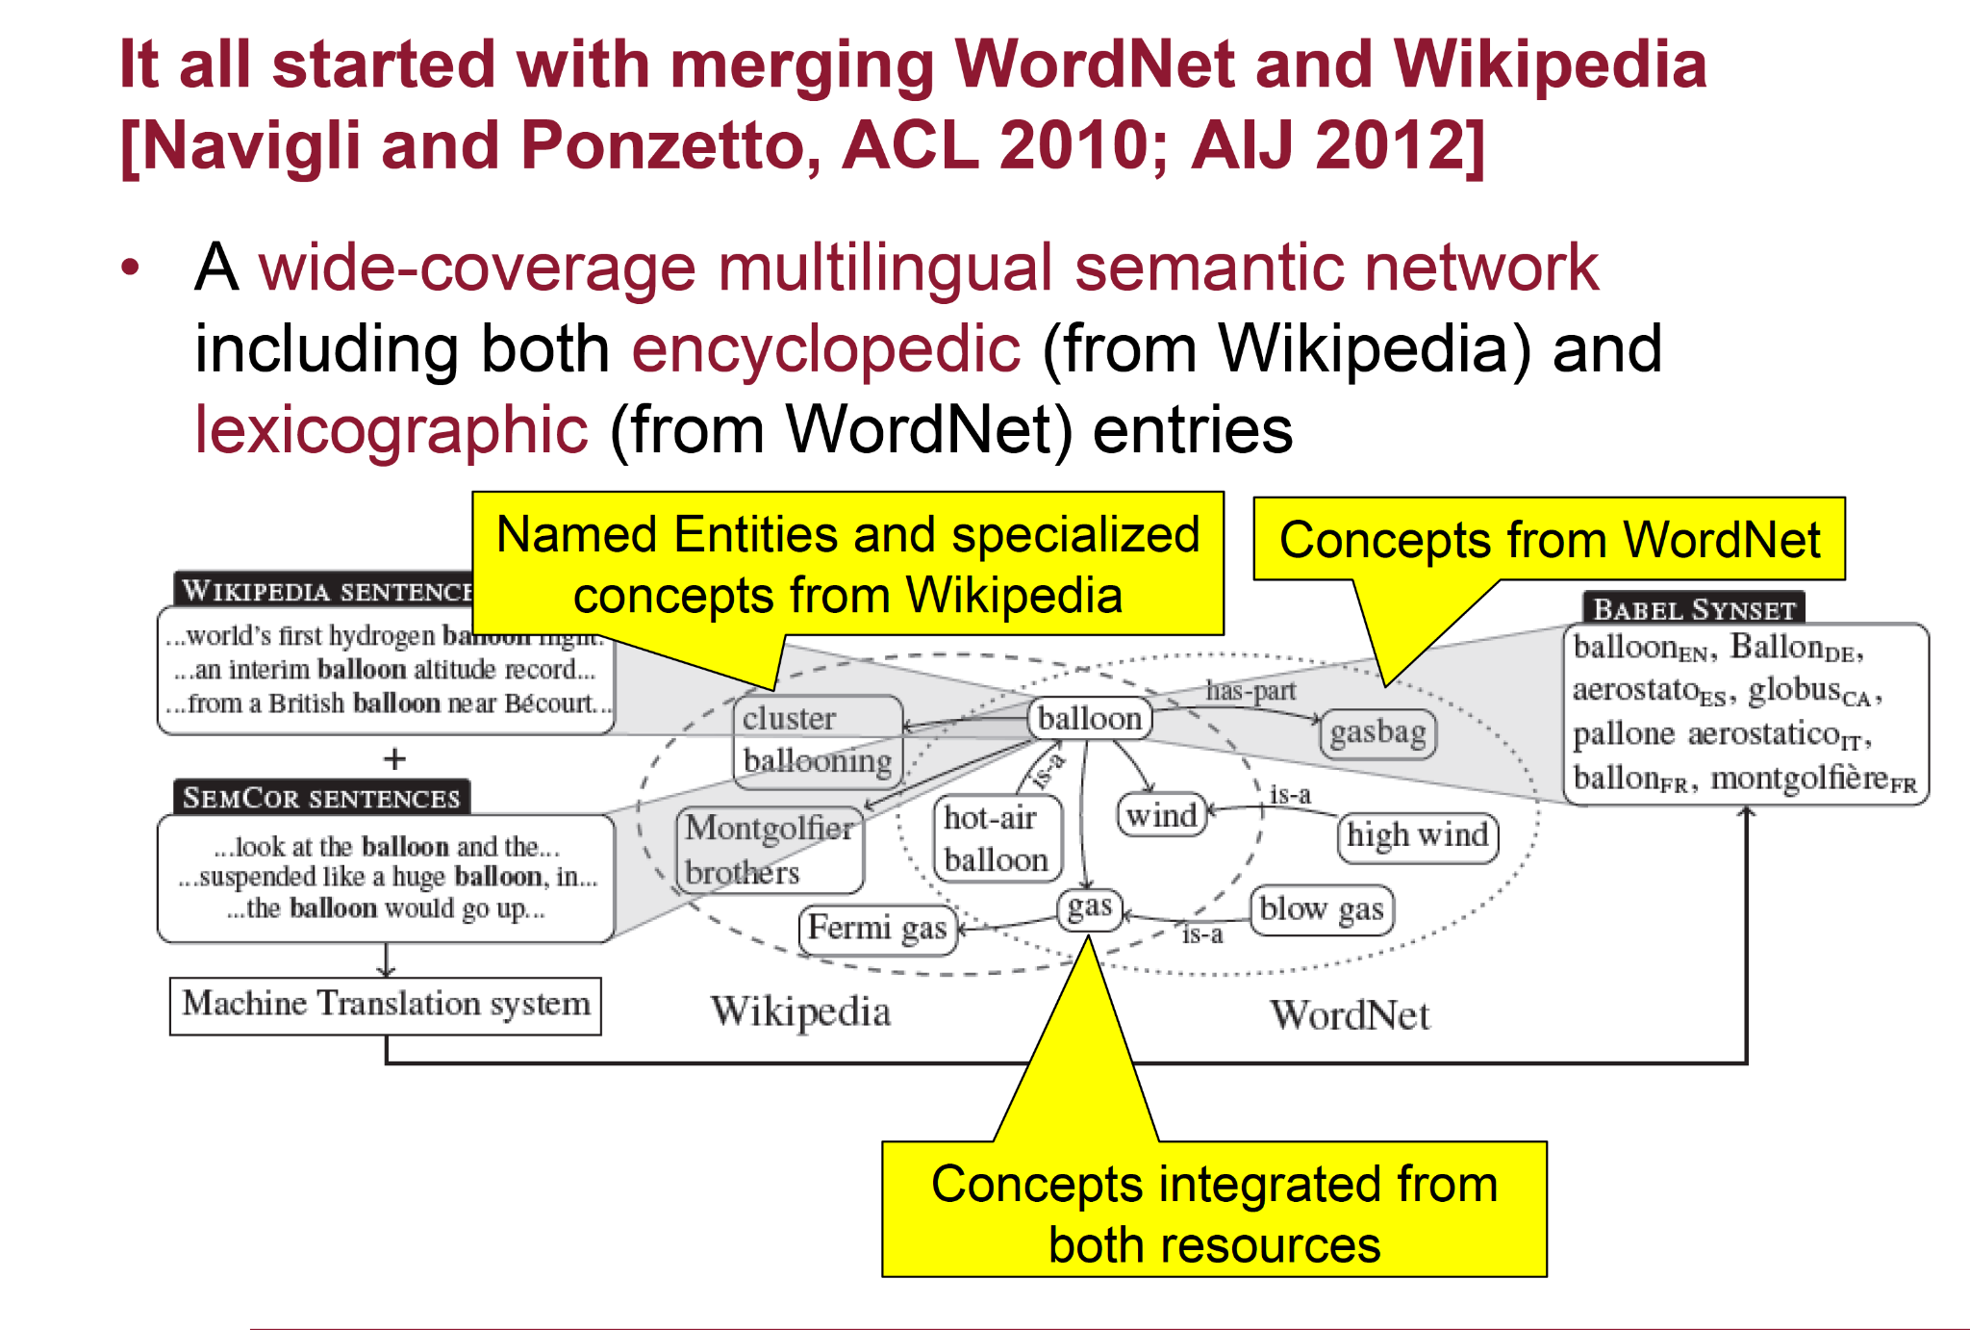
Natural Language Processing - 1.10 Semantics

Slide 68
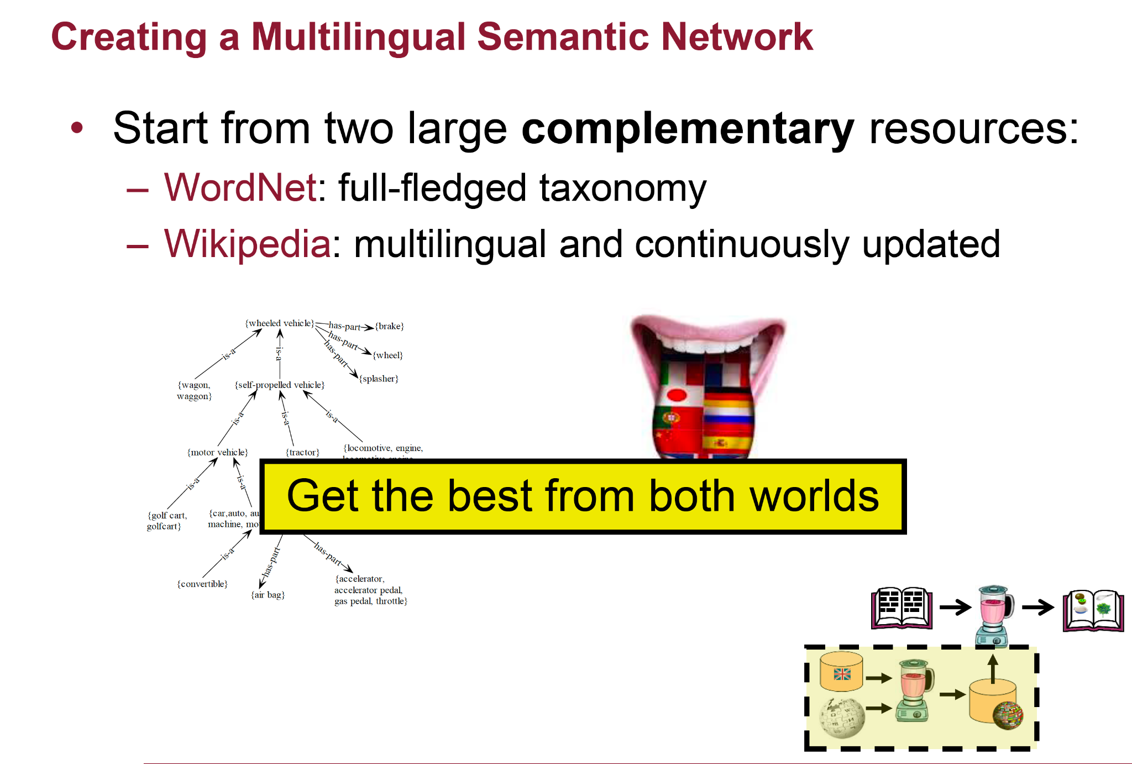
Natural Language Processing - 1.10 Semantics

Slide 69
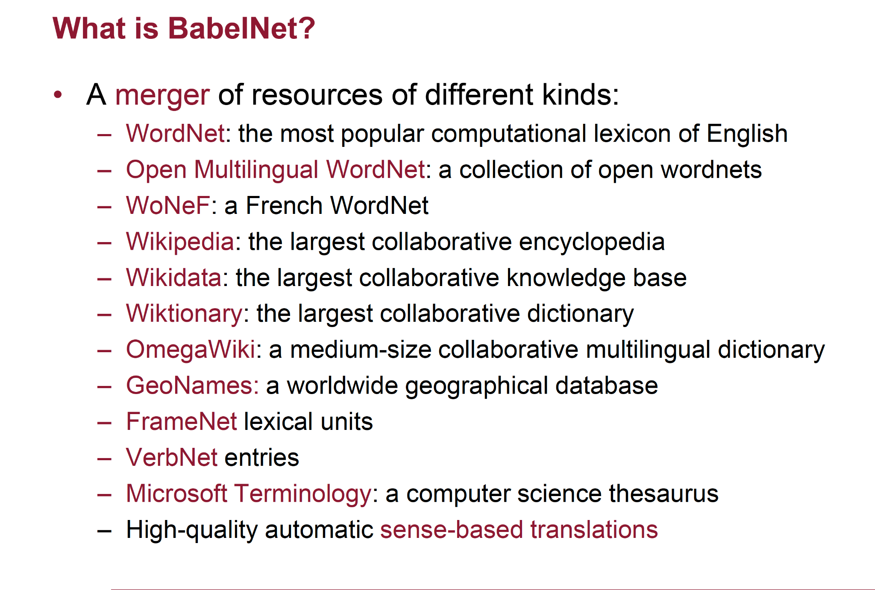
Natural Language Processing - 1.10 Semantics

Slide 70
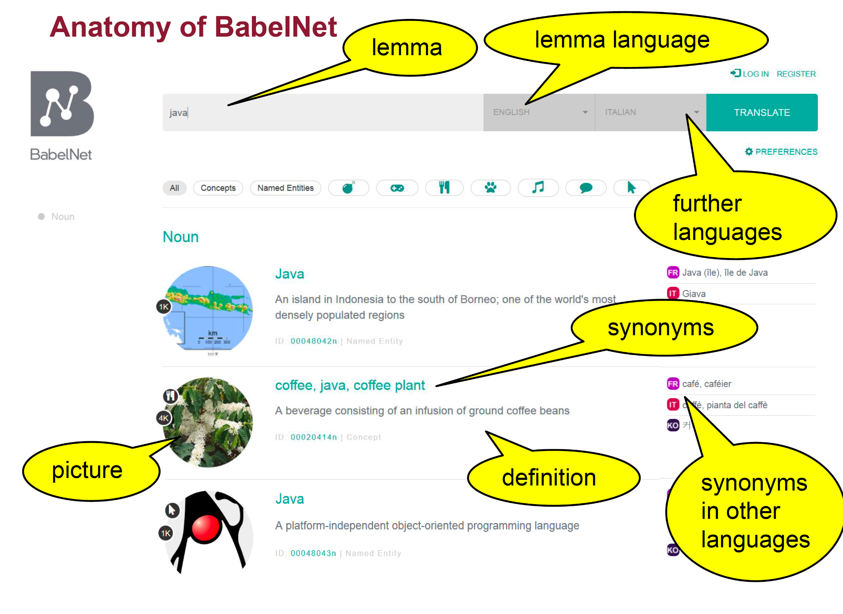
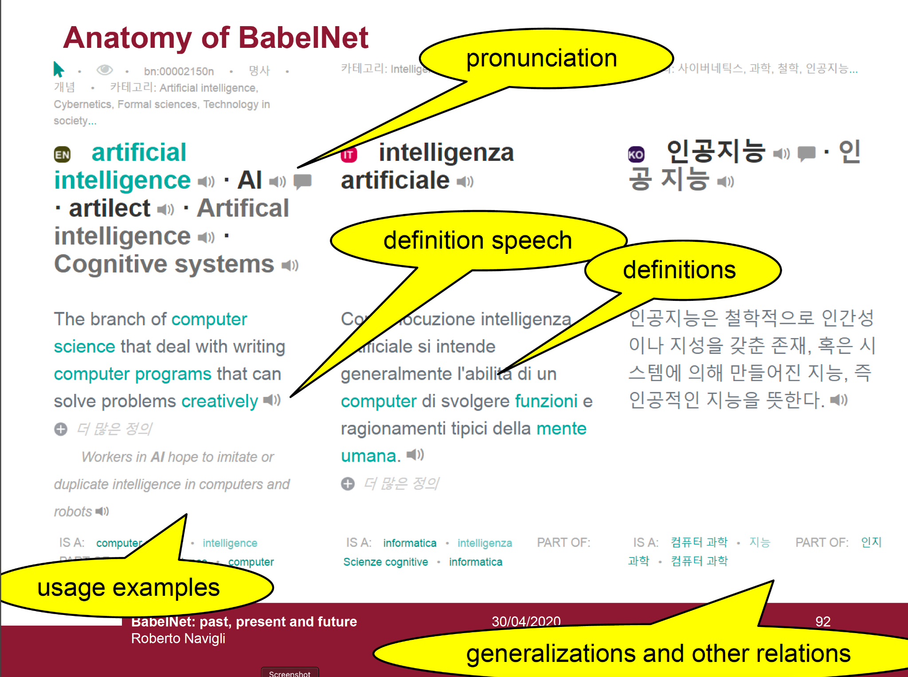
Natural Language Processing - 1.10 Semantics

Slide 71
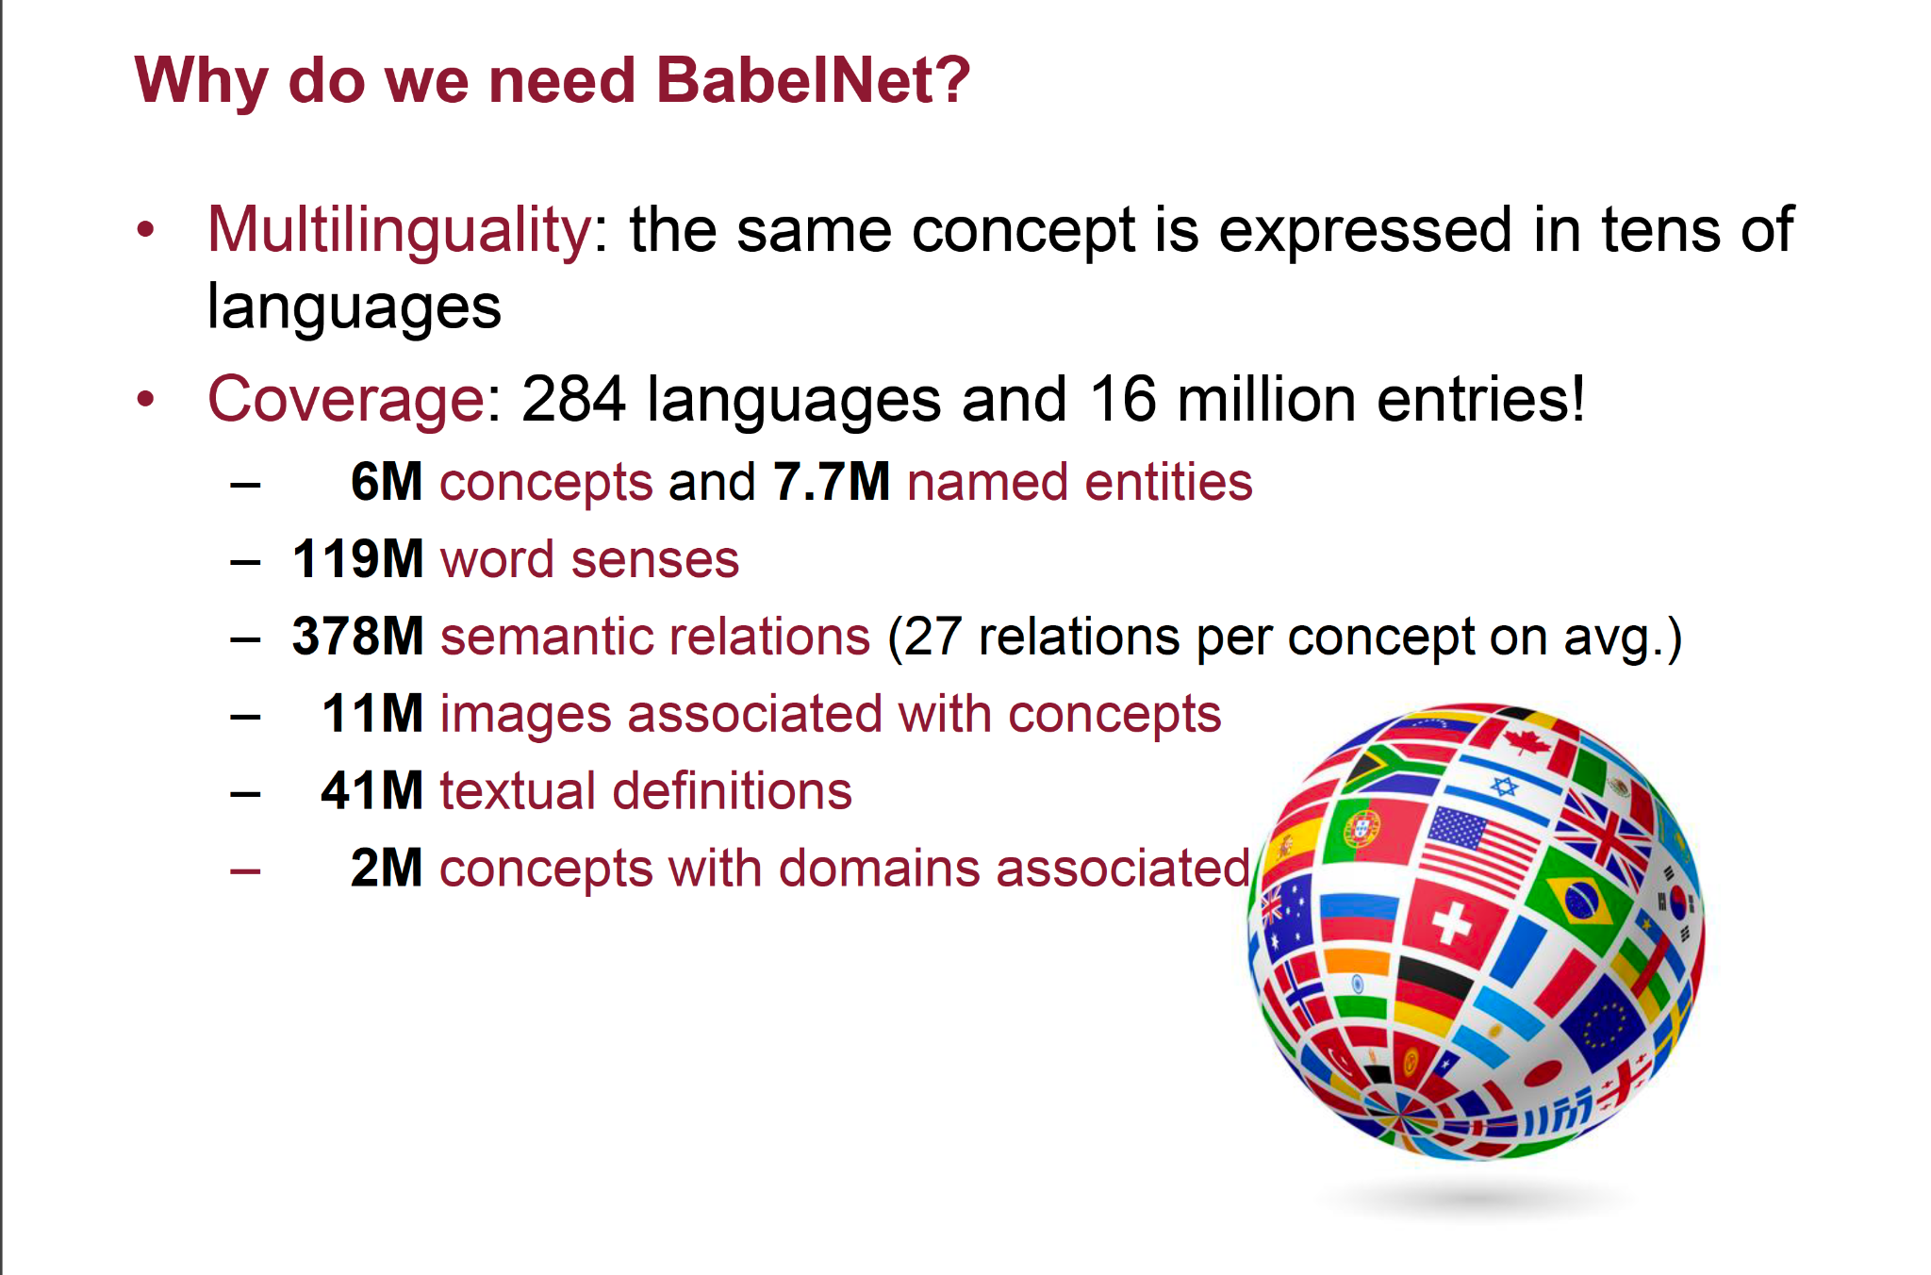
Natural Language Processing - 1.10 Semantics

Slide 72
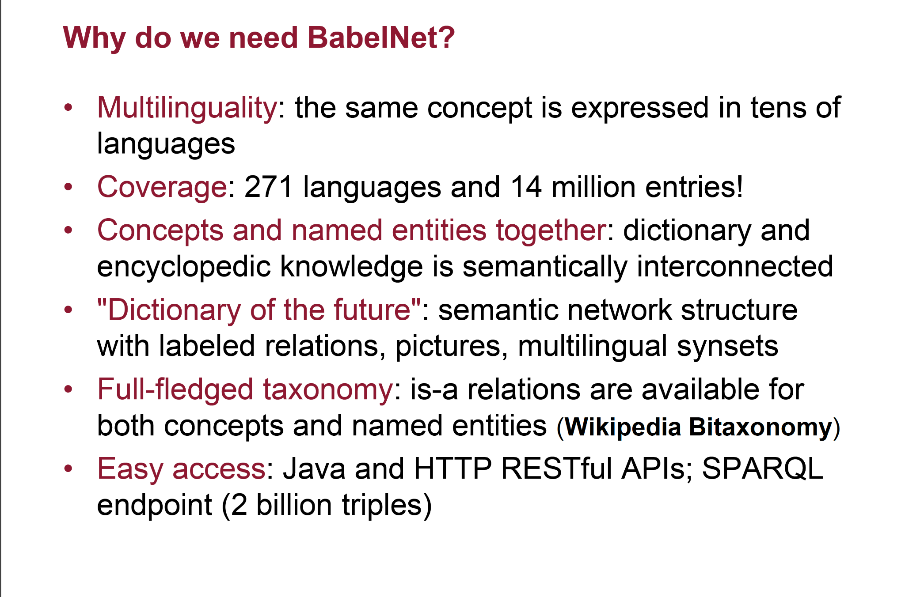
Natural Language Processing - 1.10 Semantics

Slide 73
Do we need knowledge in some form?
Natural Language Processing - 1.10 Semantics

Slide 74
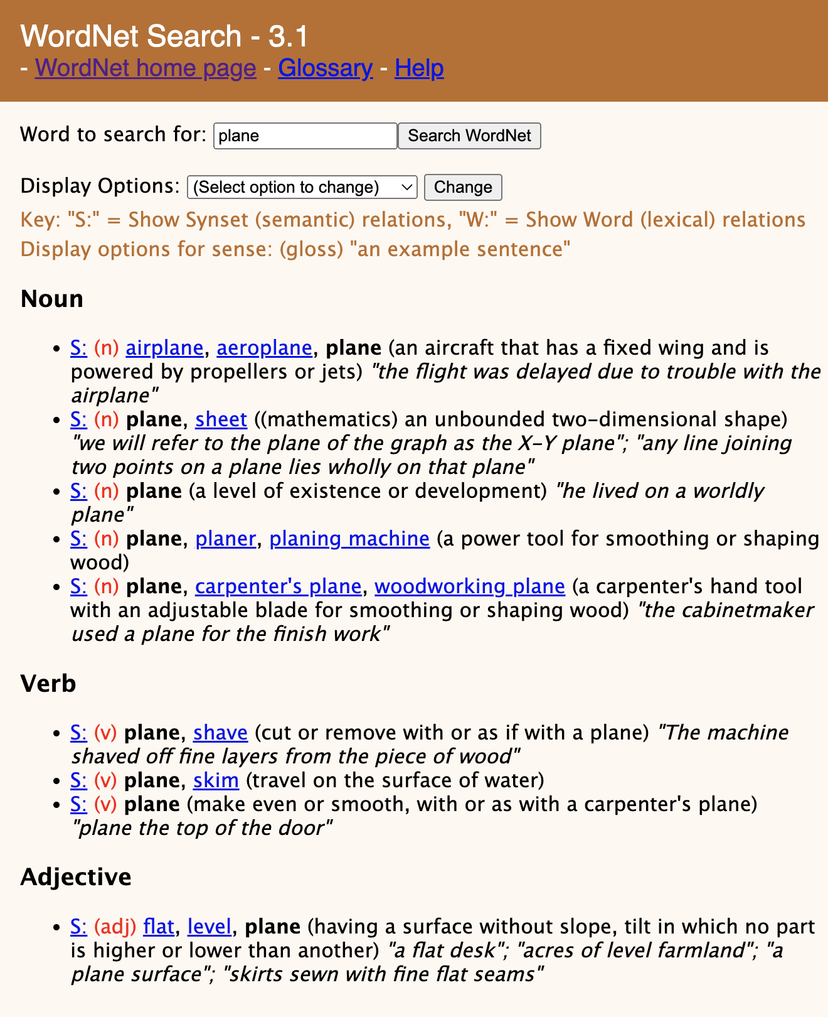
Word Sense Disambiguation (WSD)
Definition:
given a word in context,
(e.g., “I like planes and aeronautics in general”)
and a fixed inventory of potential word senses
(e.g., WordNet)
decide the most suitable synsets, if any.
(e.g., plane_{n}¹)
Natural Language Processing - 1.10 Semantics

Slide 75
Word Sense Disambiguation (WSD): variants
Definition:
Lexical Sample task
◦ Small pre-selected set of target words to be disambiguated
◦ And inventory of senses for each word
All-words task
◦ Every word in an entire text to be disambiguated
◦ A lexicon with senses for each word
◦ Sort of like part-of-speech tagging
◦ Except each lemma has its own tagset
Natural Language Processing - 1.10 Semantics

Slide 76
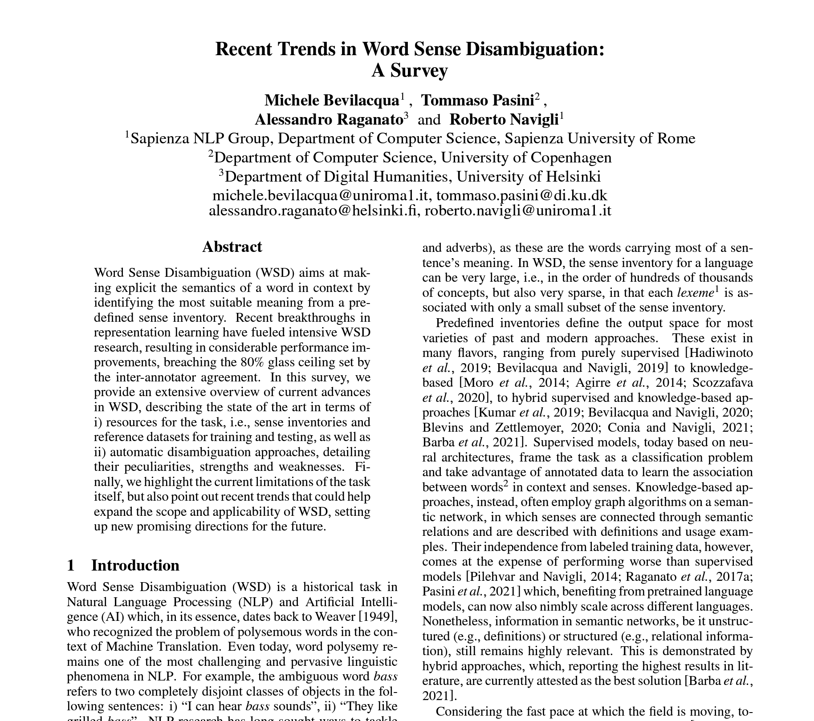
Word Sense Disambiguation (WSD)
Supervised
Unsupervised
Minimally supervised
Neural WSD
https://www.ijcai.org/proceedings/2021/593
Natural Language Processing - 1.10 Semantics

Slide 77
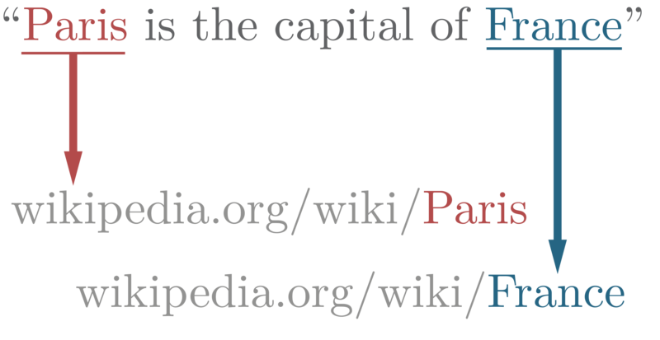
Entity Linking
From Wikipedia:
Entity linking, also referred to as named-entity linking (NEL), named-entity disambiguation (NED), named-entity recognition and disambiguation (NERD) or named-entity normalization (NEN) is the task of assigning a unique identity to entities (such as famous individuals, locations, or companies) mentioned in text.
example of text wikification
Natural Language Processing - 1.10 Semantics

Slide 78
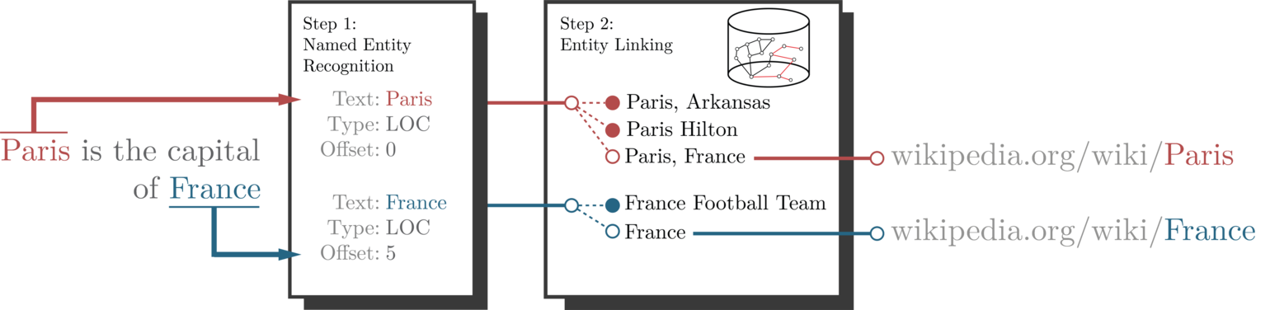
Entity Linking
From Wikipedia:
Text-based approaches, which make use of textual features extracted from large text corpora (e.g. Term frequency–Inverse document frequency (Tf–Idf), word co-occurrence probabilities, etc...).^{[25][16]}
Graph-based approaches, which exploit the structure of knowledge graphs to represent the context and the relation of entities.^{[3][26]}
Natural Language Processing - 1.10 Semantics

Slide 79
Relation Extraction
capitalOf(Paris,France)
https://en.wikipedia.org/wiki/Relationship_extraction
Natural Language Processing - 1.10 Semantics

Slide 80
Ontology Learning
From Wikipedia:
Ontology learning (ontology extraction, ontology generation, or ontology acquisition) is the automatic or semi-automatic creation of ontologies, including extracting the corresponding domain's terms and the relationships between the concepts that these terms represent from a corpus of natural language text, and encoding them with an ontology language for easy retrieval. As building ontologies manually is extremely labor-intensive and time-consuming, there is great motivation to automate the process.
Typically, the process starts by extracting terms and concepts or noun phrases from plain text using linguistic processors such as part-of-speech tagging and phrase chunking. Then statistical^{[1]} or symbolic^{[2][3]} techniques are used to extract relation signatures, often based on pattern-based^{[4]} or definition-based^{[5]} hypernym extraction techniques.
https://en.wikipedia.org/wiki/Ontology_learning
Natural Language Processing - 1.10 Semantics

Slide 81

Ontolearn Reloaded
https://direct.mit.edu/coli/article/39/3/665/1442/OntoLearn-Reloaded-A-Graph-Based-Algorithm-for
Natural Language Processing - 1.10 Semantics

Slide 82
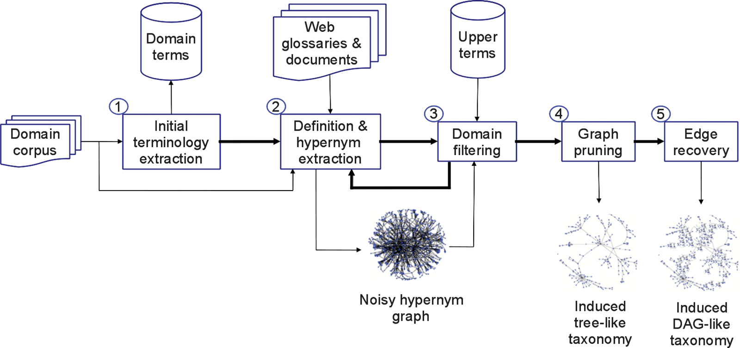
Ontolearn Reloaded
One of my current research interests
https://www.youtube.com/watch?v=-k3cOEoI_Dk
Natural Language Processing - 1.10 Semantics

Slide 83

Q&A
Natural Language Processing - 1.10 Semantics

Slide 84
Resources and References
[Jurafsky&Martin, 2022] Jurafsky and Martin. Speech and Language Processing, Prentice Hall, third edition https://web.stanford.edu/~jurafsky/slp3/ed3book.pdf
[Ogden&Richards, 1923] Ogden, Charles Kay & Richards, Ivor Armstrong (1923). The Meaning of Meaning: A Study of the Influence of Language Upon Thought and of the Science of Symbolism. London, England: Kegan, Paul, Trench, Trubner.
https://pure.mpg.de/rest/items/item_2366948/component/file_2366947/content
[Erk and McCarthy, 2009] Katrin Erk and Diana McCarthy. 2009. Graded Word Sense Assignment. In Proceedings of the 2009 Conference on Empirical Methods in Natural Language Processing, pages 440–449, Singapore. Association for Computational Linguistics. https://aclanthology.org/D09-1046/
[Pustejovsky, 1991] James Pustejovsky. 1991. The Generative Lexicon. Computational Linguistics, 17(4):409–441.
https://aclanthology.org/J91-4003/
[Miller et al., 1990] George A. Miller, Richard Beckwith, Christiane Fellbaum, Derek Gross, Katherine J. Miller, Introduction to WordNet: An On-line Lexical Database*, International Journal of Lexicography, Volume 3, Issue 4, Winter 1990, Pages 235–244, https://doi.org/10.1093/ijl/3.4.235
[Vossen,1998] Vossen, P. Introduction to EuroWordNet. Computers and the Humanities 32, 73–89 (1998). https://doi.org/10.1023/A:1001175424222
[Tufis et al.,2004] Dan Tufis, Radu Ion, and Nancy Ide. 2004. Word Sense Disambiguation as a Wordnets’ Validation Method in Balkanet. In Proceedings of the Fourth International Conference on Language Resources and Evaluation (LREC’04), Lisbon, Portugal. European Language Resources Association (ELRA). https://aclanthology.org/L04-1119/
[Atserias et al.,2004] Atserias, Jordi & Villarejo, Luis & Rigau, German & Agirre, Eneko & Carroll, J. & Magnini, Bernardo & Vossen, Piek. (2004). The MEANING Multilingual Central Repository. https://adimen.si.ehu.es/~rigau/publications/gwc04-avracmv.pdf
Natural Language Processing - 1.10 Semantics

Slide 85
Resources and References
[Navigli&Ponzetto, 2010] Roberto Navigli and Simone Paolo Ponzetto. 2010. BabelNet: Building a Very Large Multilingual Semantic Network. In Proceedings of the 48th Annual Meeting of the Association for Computational Linguistics, pages 216–225, Uppsala, Sweden. Association for Computational Linguistics. https://aclanthology.org/P10-1023/
[Navigli&Ponzetto, 2012] Roberto Navigli, Simone Paolo Ponzetto, BabelNet: The automatic construction, evaluation and application of a wide-coverage multilingual semantic network, Artificial Intelligence, Volume 193, 2012, Pages 217-250,
ISSN 0004-3702, https://doi.org/10.1016/j.artint.2012.07.001
Natural Language Processing - 1.10 Semantics

Slide 86
**Credits
The slides of this part of the course are the result of a personal reworking of the slides and of the course material from different sources:
The NLP course of Prof. Roberto Navigli, Sapienza University of Rome
The NLP course of Prof. Simone Paolo Ponzetto, University of Mannheim, Germany
The NLP course of Prof. Chris Biemann, University of Hamburg, Germany
The NLP course of Prof. Dan Jurafsky, Stanford University, USA

